Slide 1

WINTER

Slide 2
What makes winter?
The SCREW factors describe the conditions that set the stage for winter ecology. You can remember the acronym because if you can’t adapt to these conditions, you’re SCREWed!
S-now: Snow provides habitat and insulation from the cold, but it also means that winter is a time of drought because most of the moisture is frozen.
C-old: When water freezes, it becomes jagged which presents a danger for living tissues. If cytoplasm in the cells becomes frozen, cell damage or death is likely to occur.
R-adiation: The winter season is initiated because the tilt of the Earth’s axis relative to its orbit around the sun means that we receive less insolation (incoming energy from the sun).
E-nergy: The reduction in insolation results in an energy debt in ecosystems. Less photosynthesis means that less energy is available for consumers. Most organisms are living off of energy stored in their own bodies, or the energy that other organisms are storing
W-ind: Winter winds cause evaporation which means that winter drought is even more challenging. This evaporation also causes organisms to loose heat.

Slide 3
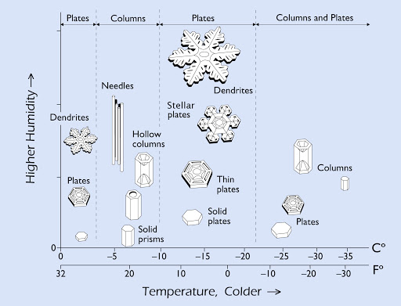
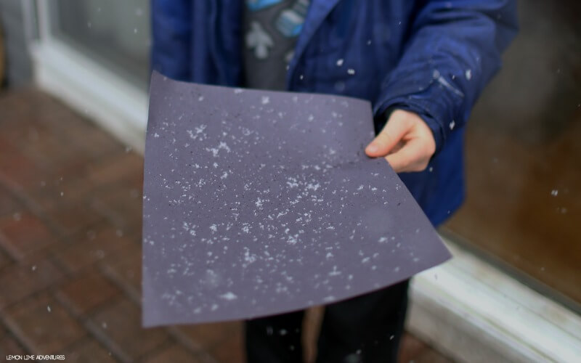
SNOW CRYSTALS
Temperature and humidity interact to form different types of snow crystals.
Some structures are large enough to be seen with the naked eye, but others require a hand lense.
Bring a black piece of paper into the field to collect snowflakes; if you hold them in your hand, the flakes will melt too quickly to observe.

Slide 4
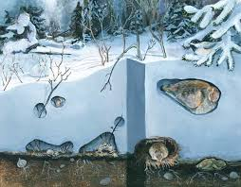
Subnivean Life (Sub=below, nivean=snow)
The snowpack acts as an insulator and traps geothermal heat. This heat causes snow to melt and form a gap between the earth and the snow.
The temperature in the subnivean ecosystem remains at about 0°C, even when temperatures dip below -30°C
In this space, entire food webs exist where small mammals (like mice, voles, and shrews) feed off of seeds, roots, and leaves of tender plants, and larger mammals (fox, coyote, ermine) prey on them.
If you find small rodent tracks in the snow, follow them to the base of a plant where you’ll find a small hole that leads into the subnivean world!

Slide 5
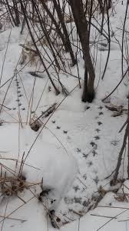
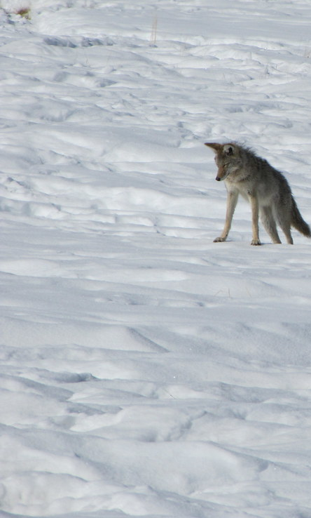
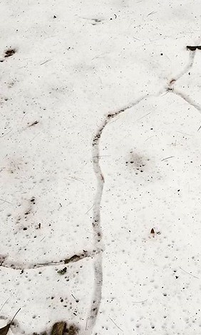
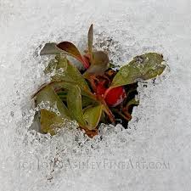
SIGNS OF THE SUBNIVEAN…
Plants like bearberry, juniper, and some grasses will stay green and photosynthesize in the subnivean zone.
Tracks leading to tunnel openings
Predators stalking subnivean prey
Tunnels emerging as snow melts

Slide 6
WINTER ADAPTATIONS: TREES
Coniferous trees retain their leaves (needles) so they are ready to photosynthesize during favorable conditions. Needles are waxy and thin to minimize evaporation. They are long and densely bunched to increase humidity and heat retention.
Conifers add sugars and proteins their sap to create an antifreeze.
Their upward-curving, flexible branches allow for snow loading without breakage.
Deciduous trees drop their leaves each year to prevent damage from freezing and snow loading. They sense the change in the length of day using molecules called “phytochromes”. This initiates the process of leaf drop.
These trees begin preparing for winter in summer when they create buds which contain next year’s leaves. These buds can be used to identify trees during the winter.

Slide 7
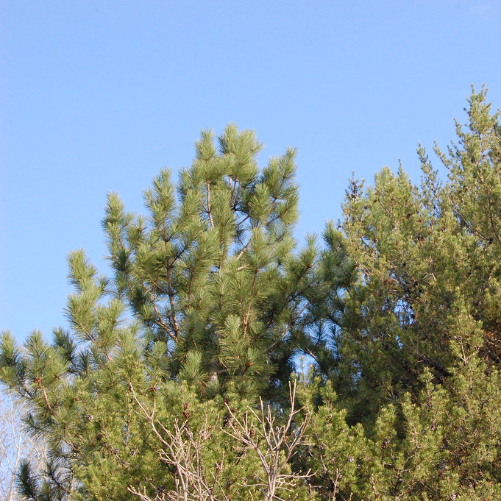
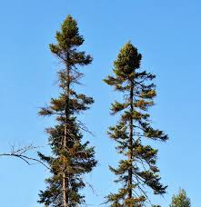
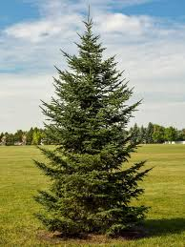
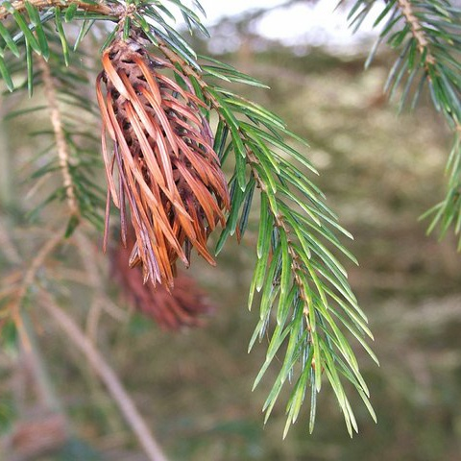
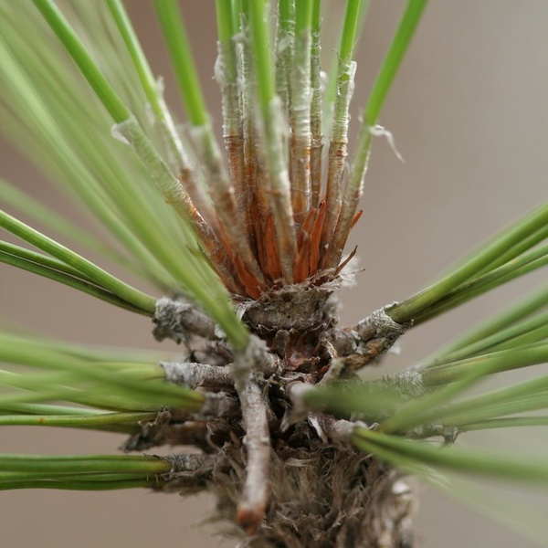
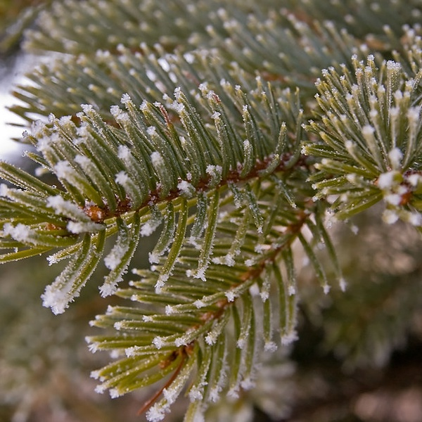
TREE ID IN WINTER: Conifers
PINE
SPRUCE
FIR
SPRUCE
Pine needles grow in pairs.
Spruce needles are short, sharp, and square.
Fir needles are flat.

Slide 8
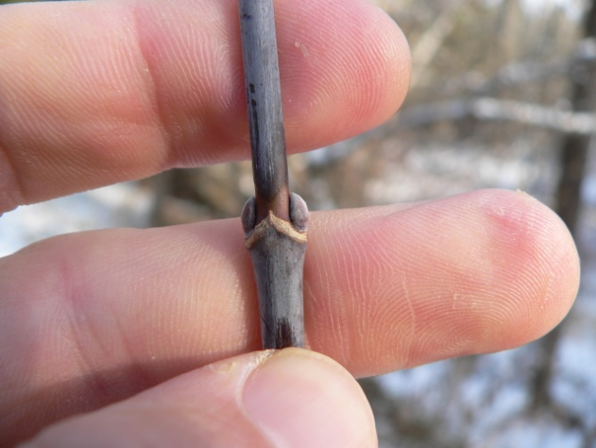
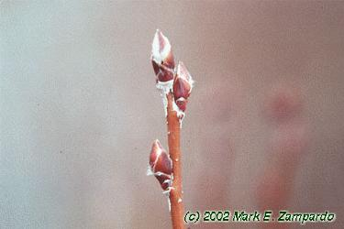
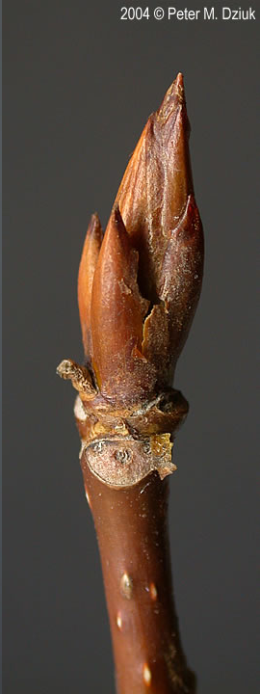
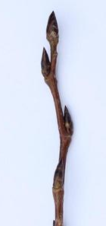
TREE ID IN WINTER: Deciduous
Trembling Aspen (Populous tremuloides)
White powdery bark with medium brown twigs
Manitoba Maple (Acer nuegundo)
Look for “m” shape between buds.
Saskatoon Berry (Almenchier alnifolia)
Look for white fuzz on the tips of the buds
Blasam Poplar
(Populous balsmifera)
These are the biggest buds found in this region.

Slide 9
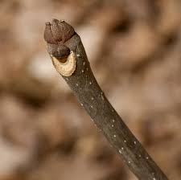
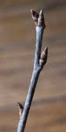
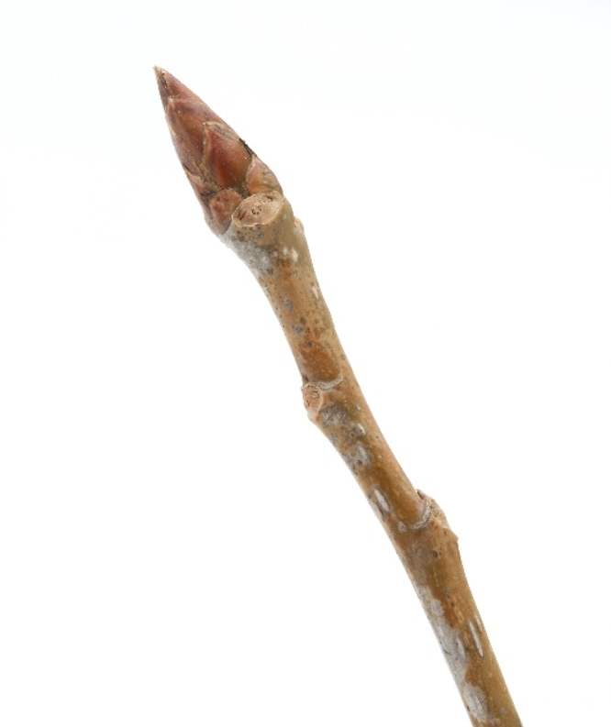
TREE ID IN WINTER: Deciduous
Plains Cottonwood, (Populous deltoides)
Bark on the twigs is a warm brown with ridges running the length of the twig. This gives the twig a square-ish look
Green Ash
(Fraxinus pensylvinica)
Terminal bud looks like a deer hoof, and other buds are small, round balls.
Chokecherry, (Prunus virginiana)
Always has a double bud at the end of the twig.

Slide 10
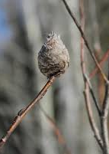
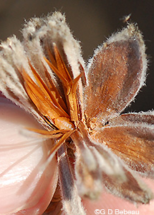
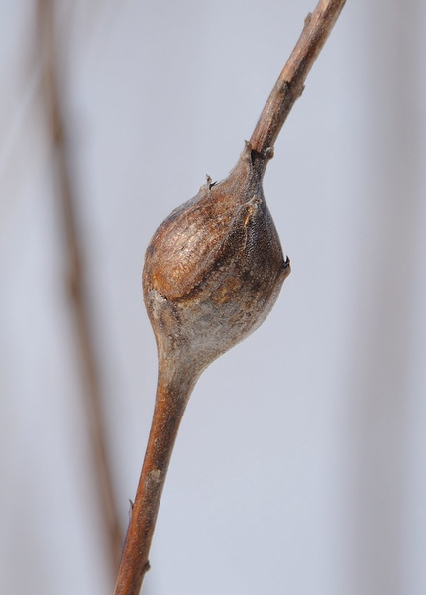
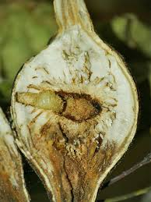
GALLS: swollen plant tissue created by insect activity, which protects the eggs or larva from predators and cold temperatures, and provides food for the organism growing inside.
Pinecone Willow Gall: These galls grow on the tips of willow twigs and resemble pinecones.
The gall is created as a reaction to chemicals released from the female midge that lays her eggs on the twig, as well as the larva’s saliva.
Goldenrod Fly Gall: the female fly lays eggs in the stem of the goldenrod plant. When the eggs hatch, the larva begin feeding and their saliva encourages the growth of the gall.
Before winter, the larva excavates a tunnel through the gall, leaving only the outer layer intact. In the spring, the fly emerges as a mature adult.

Slide 11
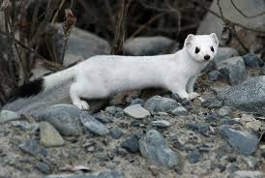
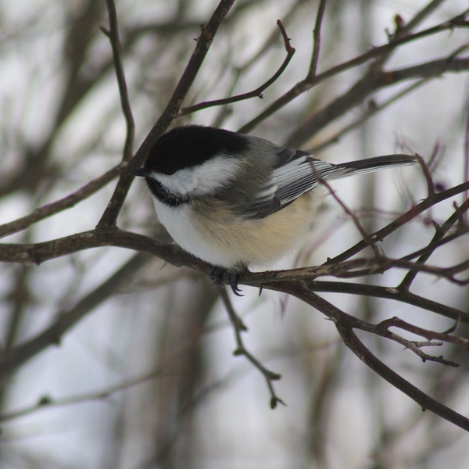
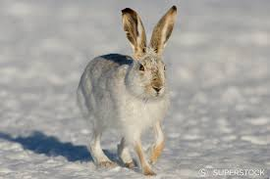
CHIONOPHILES (SNOW LOVERS)
Chionophiles are organisms that are well adapted to the snow and cold. Their adaptations tend to follow three scientific rules that allow them to conserve heat and camouflage, in winter habitats.
Bergmann’s rule: thicker, reduced surface area
Allen’s rule: shorter limbs
Gloger’s rule: light colored
Ermine, (Mustella erminia)
Jackrabbit, (Lepus townsendi)
Black Capped Chickadee,
(Poecile atricapillus)

Slide 12
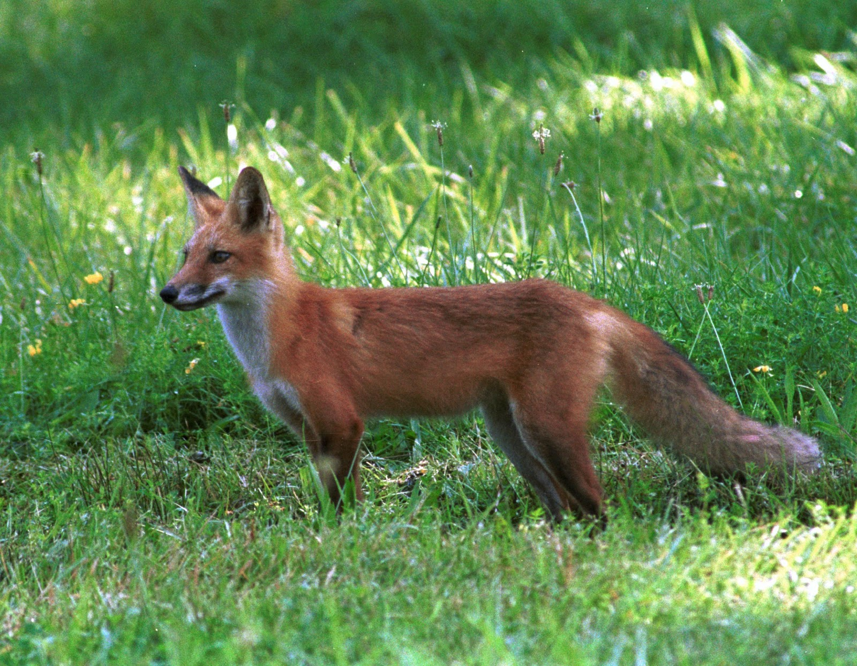
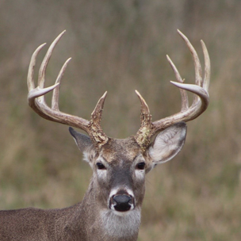
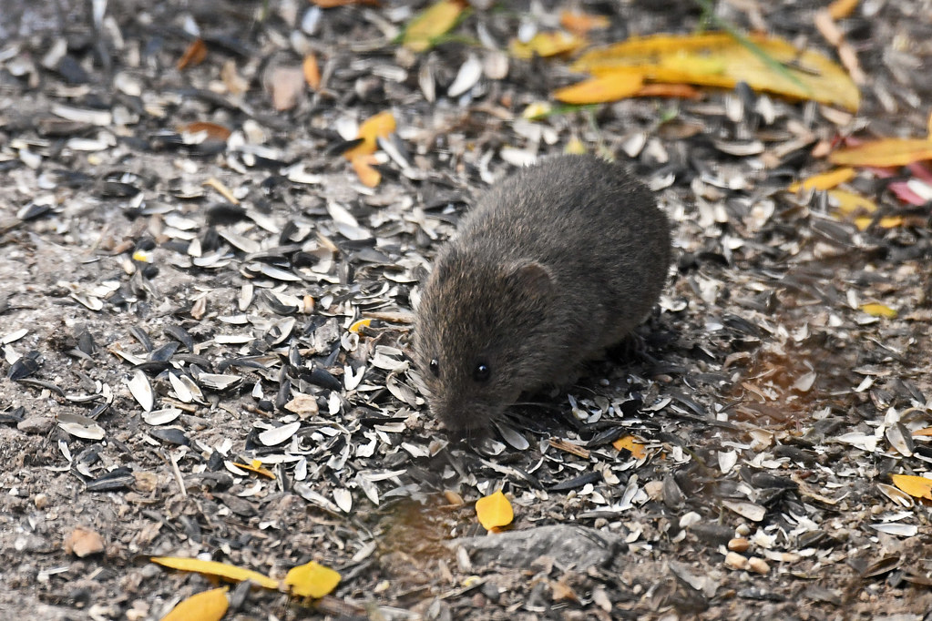
CHIONEUPHORES (SNOW TOLERATORS)
Some animals stay in winter climates, but lack the adaptations to thrive. They change their behaviors, but struggle when conditions become harsh.
Red Fox
(Vulpes Vulpes)
Meadow Vole
(Microtus pennsylvanicus)
White-tailed Deer
(Odocoileus virginianus)

Slide 13
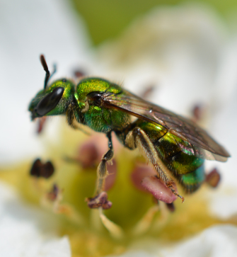
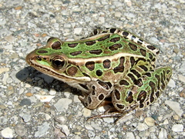
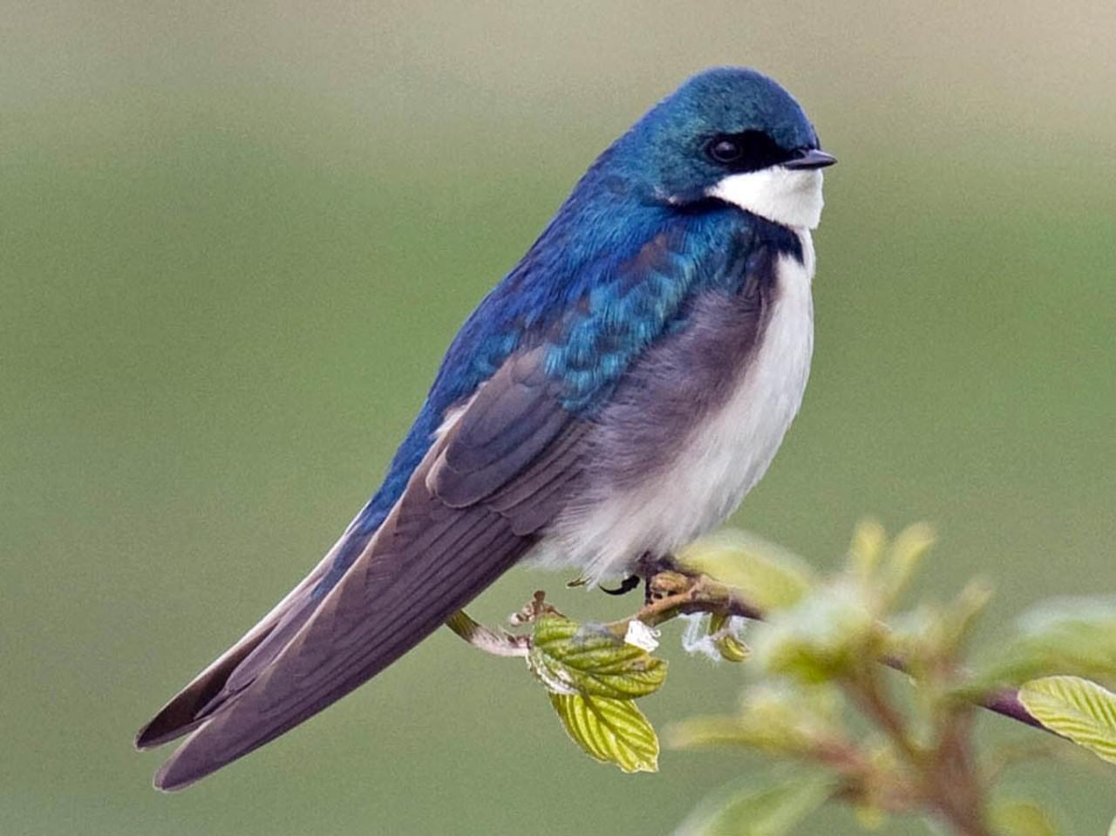
CHIONOPHOBES (SNOW HATERS)
Animals that can’t cope with winter have two options; migrate or hibernate. These animals have developed incredible adaptations that allow them to avoid the winter.
Northern Leopard Frog
(Lithobates pipiens)
Frogs go into a state of hibernation, and can even freeze solid throughout the winter.
Tree Swallow
(Tachycineta bicolor)
Tree Swallows that nest in our region can migrate as far as South America in order to avoid the cold
Sweat Bee
(Agopostomen sp.)
If female sweat bees are born late in the summer, they will hibernate underground or in a rotten log.

