Slide 1

ROCKS

Slide 2
ROCKS
The three main types of rock are sedimentary, metamorphic, and igneous. The differences among them have to do with how they are formed.
Sedimentary (Example- Limestone)
Particles of sand, shells, pebbles- Together, all these particles are called sediment.
The sediment accumulates in layers and over a long period of time hardens into rock.
Generally, fairly soft and may break apart easily.
You can often see particles in the rock, and it is usually the only type that contains fossils.
Metamorphic (Example- Marble)
Metamorphic rocks are formed under the surface of the earth.
Change due to intense heat and pressure (squeezing).
These rocks often have ribbonlike layers and may have shiny crystals.
Igneous (Example- obsidian)
Igneous rocks are formed when magma cools and hardens.
Sometimes the magma cools inside the earth, and other times it erupts onto the surface from volcanoes (in this case, it is called lava).
When lava cools very quickly, no crystals form and the rock looks shiny and glasslike.
Sometimes gas bubbles are trapped in the rock during the cooling process, leaving tiny holes and spaces in the rock.
https://www.learner.org/wp-content/interactive/rockcycle/types.html

Slide 3
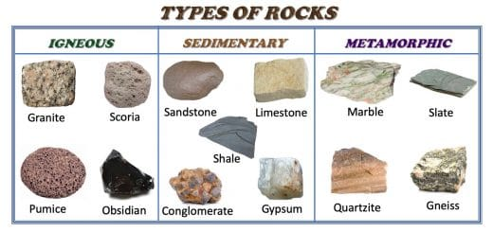
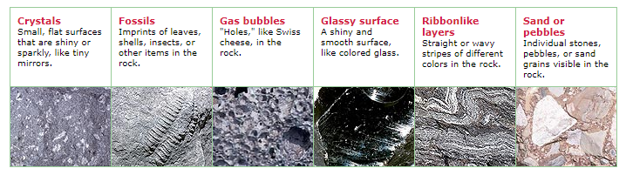
METAMORPHIC
SEDIMENTARY
IGNEOUS
IGNEOUS
METAMORPHIC
SEDIMENTARY
https://www.learner.org/wp-content/interactive/rockcycle/types.html

Slide 4
