Slide 1

DECOMPOSERS

Slide 2
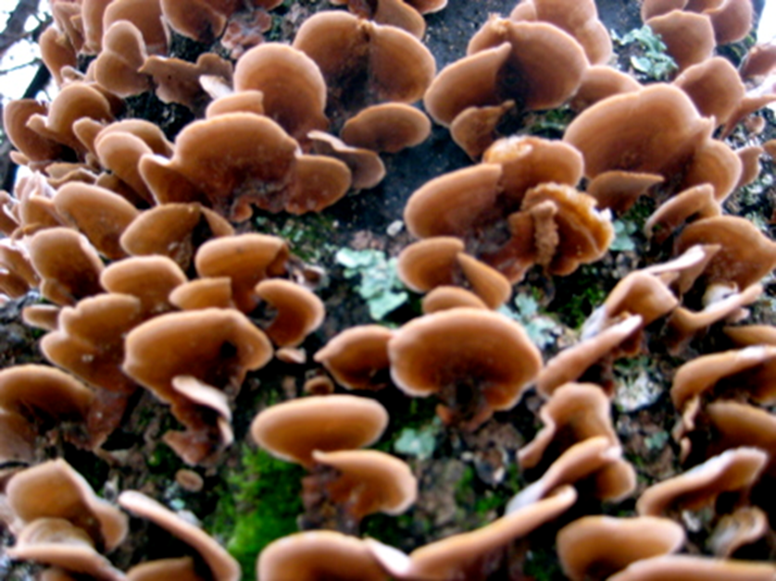
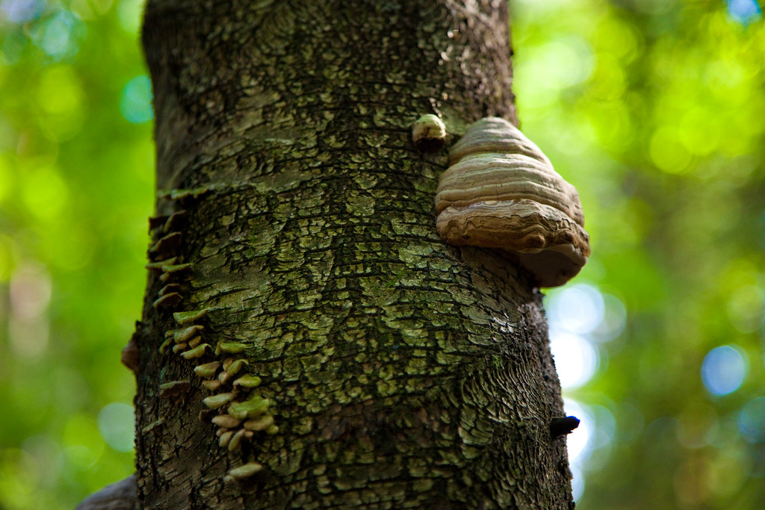
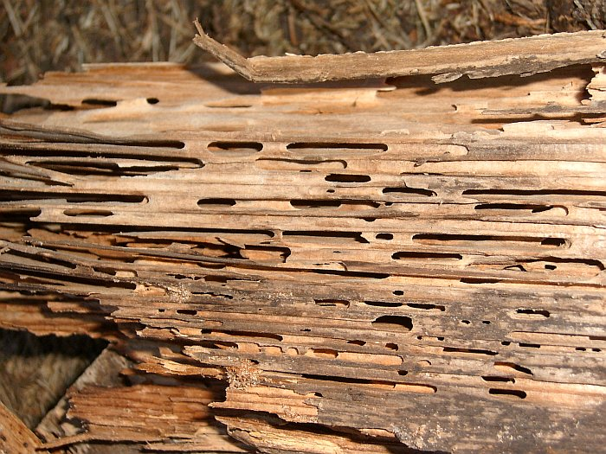
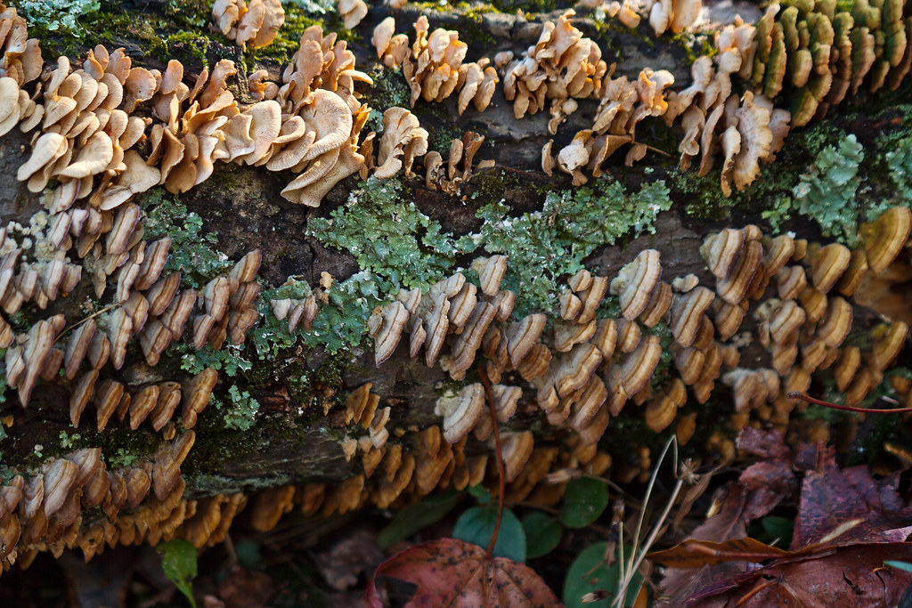
SHELF (BRACKET) FUNGI
HOOF FUNGUS
CARPENTER ANTS ACTIVITY
DECOMPOSITION

Slide 3
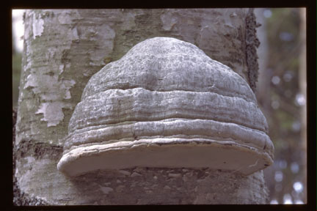
DECOMPOSITION
Important and often overlooked part of ecosystems- decomposition: the breaking down of (dead) organic material into simpler forms. Would you want to go outside if there were big piles of dead stuff everywhere? Decomposers help us to return dead stuff to the soil.
Carpenter Ants- Build their nest and burrows in dead wood and logs but do not eat the wood. The worker ants, which are infertile females are among the largest known ants.
Scientific/Latin: pennsylvanicus, French- la fourmi, Cree- êyik, Michif- frimii
Shelf (Bracket) Fungus (Polyporaceae)- A group of wood decomposers that grow on standing trees or fallen logs. Can you see why it would be called shelf fungus?
Hoof Fungus- A tough perennial wood decomposer that usually becomes hoof-shaped with age; it is found on standing and fallen hardwoods. Can and has been used as tinder.
Scientific/Latin: Fomes fomentarius, French- le fongus
Kuo, M. (2010, February). Fomes fomentarius. Retrieved from the MushroomExpert.Com Web site: http://www.mushroomexpert.com/fomes_fomentarius.html

Slide 4
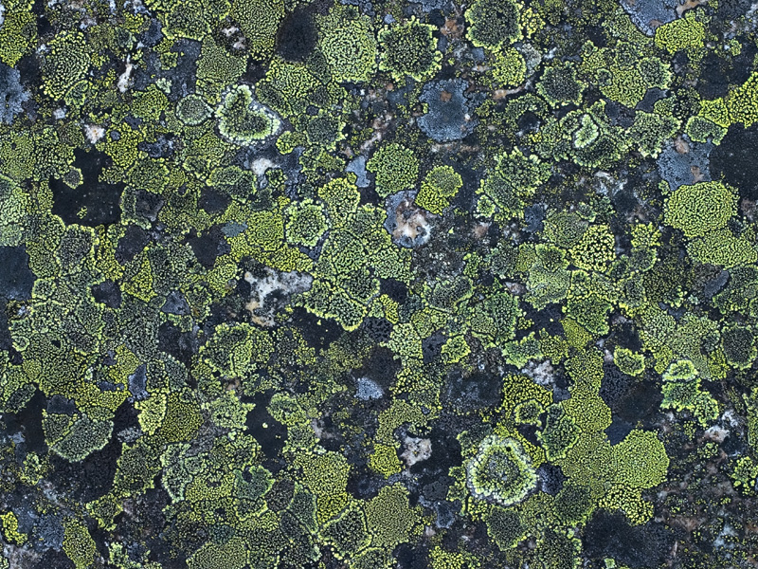
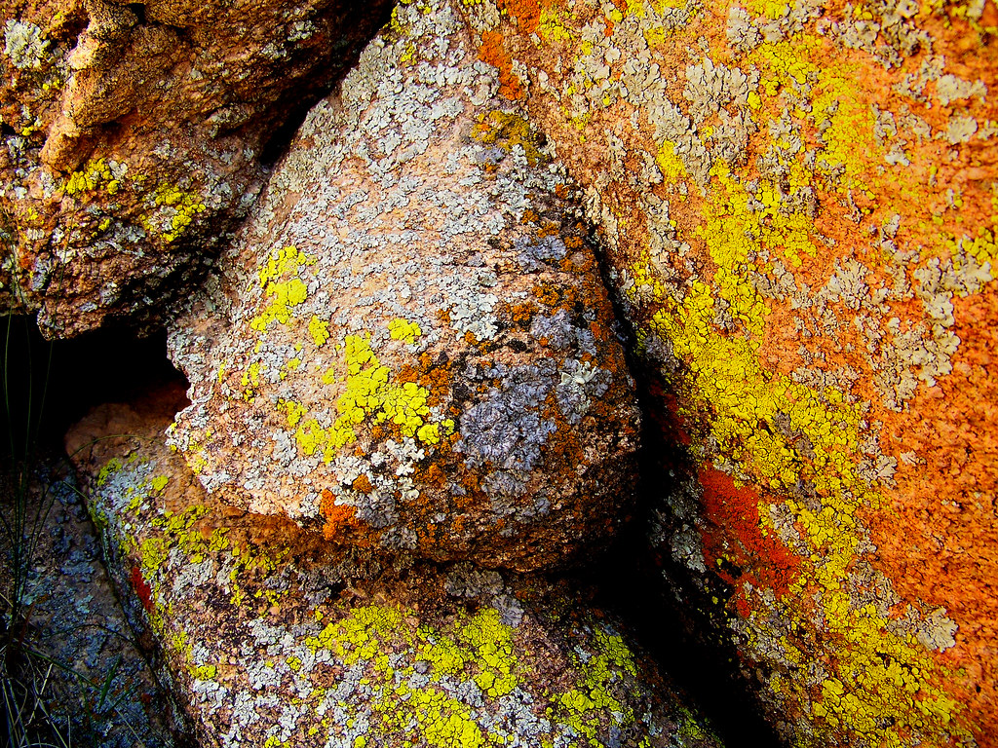
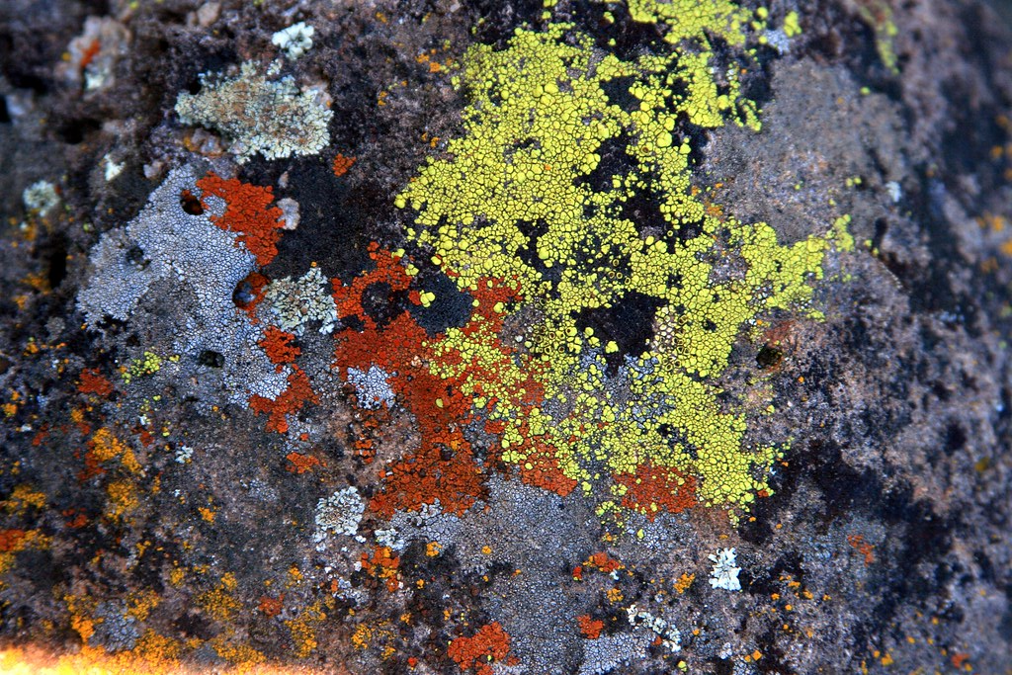
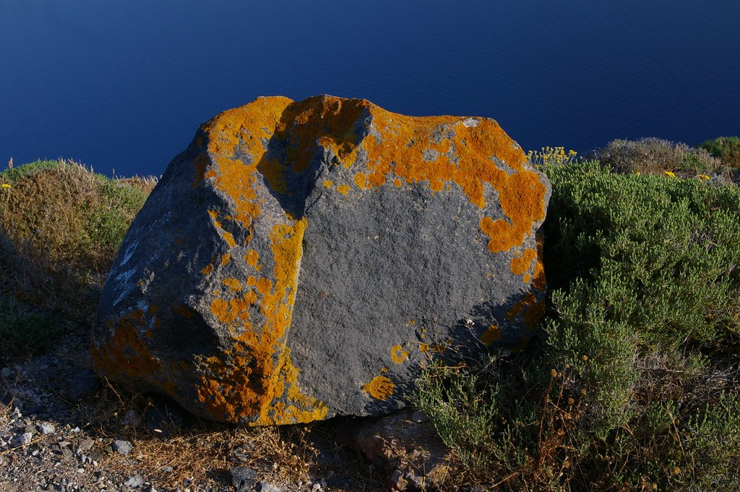
LICHEN

Slide 5
LICHEN
Found in a variety of colours: orange, green, black, yellow, pink, grey, etc. Looks like modern art!
Combination of two organisms: Algae and Fungi working together. The fungi provides structure, and the algae provides food. Lichen is both a decomposer & a producer! Combined, lichen produces an acid, which is able to break down rocks (over a long period of time)!
Lichens have been used by humans as food and as sources of medicine and dye. They also provide two-thirds of the food supply for the caribou that roam the far northern ranges.
Not moss! Although they grow in similar habitats, they are not similar in anyway to mosses or other members of the plant kingdom. They do not have any roots, stems or leaves and their chloroplasts are contained only in the algae on the top surface of the lichen.
https://www.britannica.com/science/lichen
https://www.fs.fed.us/wildflowers/beauty/lichens/biology.shtml

Slide 6
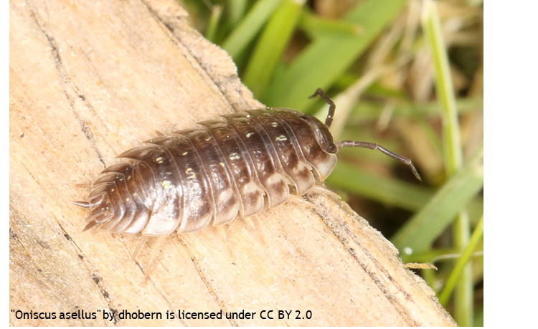
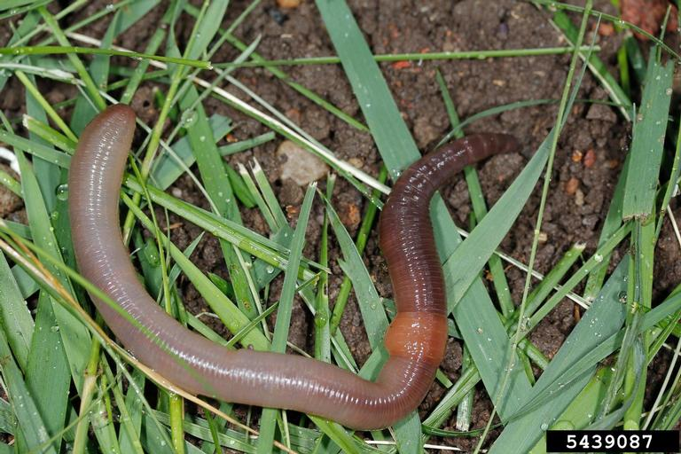
SOW BUG
Joseph Berger, Bugwood.org
DECOMPOSER INVERTEBRATES
EARTHWORM

Slide 7
INVERTEBRATES
Earthworm- Diet- Earthworms eat a range of matter and are best described as detritivores (eating decaying plant and animal matter).
Bodies- How do you know which end is the worm head? The clitellum, the thicker band you will see on mature worms, is closer to the anterior end, aka. the head. The clitellum helps to form cocoons.
Earth worms are segmented worms and have the ability to replace lost segments. However, it may be easy for a worm to replace a lost tail, but much more difficult or impossible to replace a lost head.
No teeth= no chewing. Instead- gizzard. Similar to birds. Enables them to take in larger pieces of food. Worms have five hearts! Worms do not have lungs, instead they absorb Oxygen through their skin!
Scientific/Latin: Lumbricus terrestris, French- un ver de terre, Cree- mohtêw, Michif- lii vayr di tayr
Sow Bug- Habitat & Diet- Often found under logs or in basements, as they like dark, damp places. Sowbugs feed mostly on litter (dead plant material) and fecal matter in the soil.
Bodies- Look like little armadillos and are commonly mistaken for a beetle, however, Sow bugs are not insects, they are crustaceans, like a crab or lobster. Note that they have 7 pairs of legs not 3 like an insect.
Families- Female sowbugs have a brood pouch in which their eggs are incubated until they hatch. After the young leave the pouch, they continue to live in family groups until the young are grown. Each family has a chemical "badge" which helps it to identify its relations.
Scientific/Latin: Oniscus spp,
https://www.earthwormsoc.org.uk/node/61 & Peterson FIrst Guide- Insects & https://crawford.tardigrade.net/bugs/BugofMonth17.html

