Slide 1

AQUATIC

Slide 2
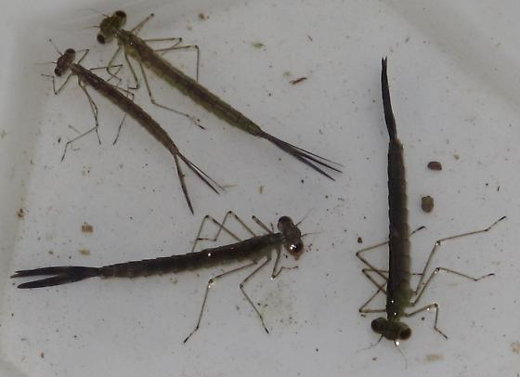
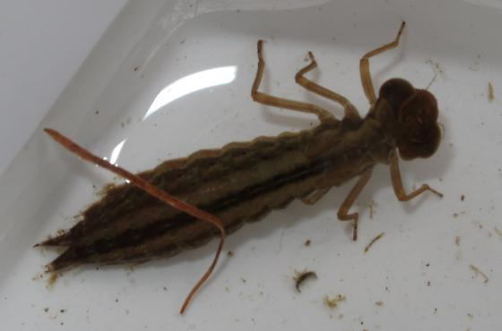
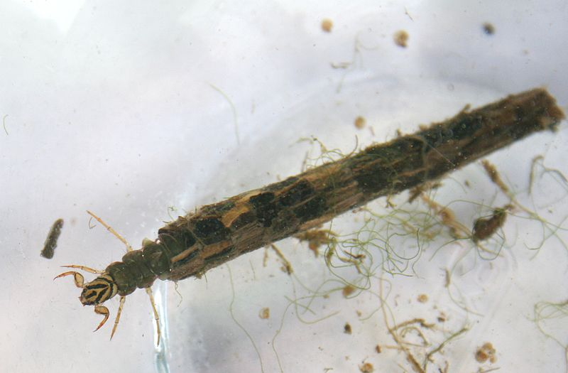
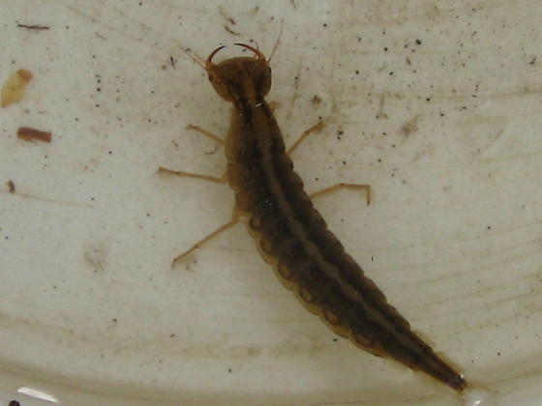
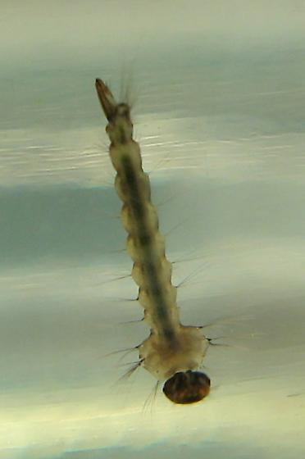
INSECT LARVAE
Copyright © 2013 Paul Crump
Copyright © 2013 Paul Crump
DAMSELFLY NYMPHS
DRAGONFLY NYMPH
CADDIS FLY LARVA
Copyright © 2012 Meghan Kemp
Predacious Diving
Beetle Larvae
WATER TIGER
Copyright © 2007 Stephen Luk
MOSQUITO LARVA

Slide 3
INSECT LARVAE AND NYMPHS
Dragonfly Nymphs- Are large predators of the aquatic invertebrate world. They have hinged mouthparts that can rapidly clamp down on their prey. Their bodies are flat, and wide when compared to damselfly nymphs. Scientific/Latin: Sub-Order- Anisoptera (many species), French-une nymphe de libellule, Cree- côwêhkanâpisîs
Damselfly Nymphs- Damselfly nymphs are long and slender, and breathe through three leaf-shaped gills at the end of their abdomens. They are also predators of the aquatic world, and have sharp mouthparts to trap their prey. Scientific/Latin: Sub-Order- Zygoptera (many species), French- une nymphe de demoiselle
Mosquito Larvae- Mosquito larvae are very poor swimmers and move about by wriggling. They breathe out of a tube that they stick above the surface of the water, and can be found in any pool of standing water. Scientific/Latin: Family- Culicidae (many species), French- le moustique, Cree- sakimês, Michif- aen marayngwayn
Predaceous Diving Beetle Larvae-These larvae are called “water tigers” because of their predatory nature. They inject digestive enzymes into their prey, and slurp out the nutritious goo with their mandibles. Scientific/Latin: Family: Dytiscidae (many species), French- un coléoptère plongeur, Cree- amiskosîs, Michif- aen manichoosh di loo Caddisfly Larvae-· Caddisfly larvae inhabit a tube that they build out of leaves, rocks, sticks, and other debris. Only their head and front legs stick out. Caddisflies are herbivores, and prefer environments that are well-oxygenated. Scientific/Latin: Order- Trichoptera (many species)

Slide 4
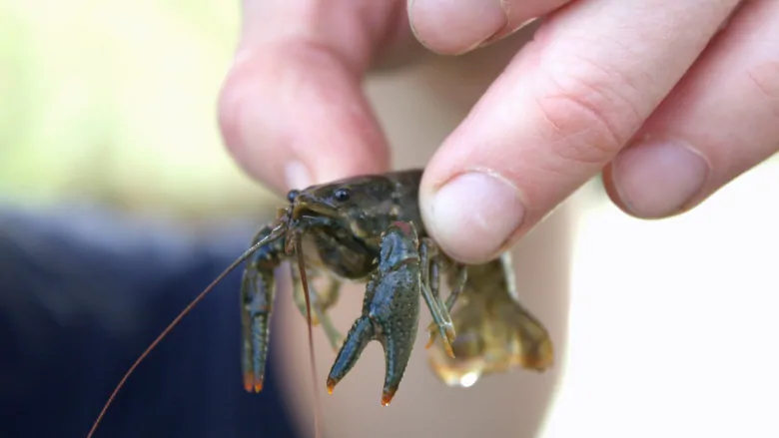
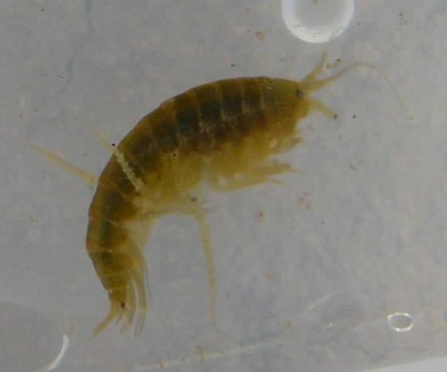
Caroline Wagner/CBC
CRAYFISH
Copyright © 2009 James Bailey
FRESHWATER SHRIMP
CRUSTACEANS

Slide 5
CRUSTACEANS
Crayfish-· Look like little lobsters, and are in the order “decapoda” (deca=ten, pod= feet). They are most active at night, but can be found under rocks and debris during the day.
Scientific/Latin: Orconectes virilus, French- une écrevisse
Freshwater Shrimp- These critters are often called “sideswimmers” because they roll onto their side or their back when they are swimming. They are omnivores, but they will rarely eat living animals.
Scientific/Latin: Order- Amphipoda (many species), French- une crevette d'eau douce, Michif- lii shrimp

Slide 6
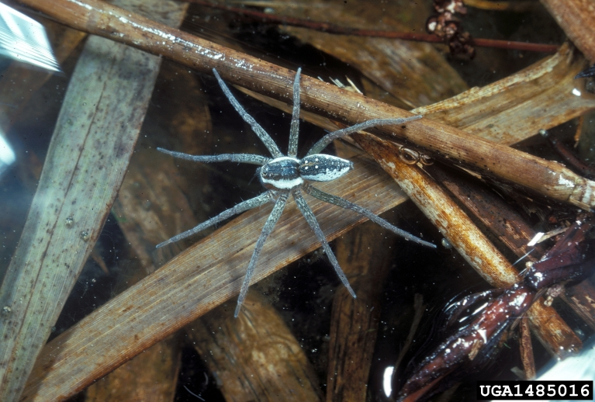
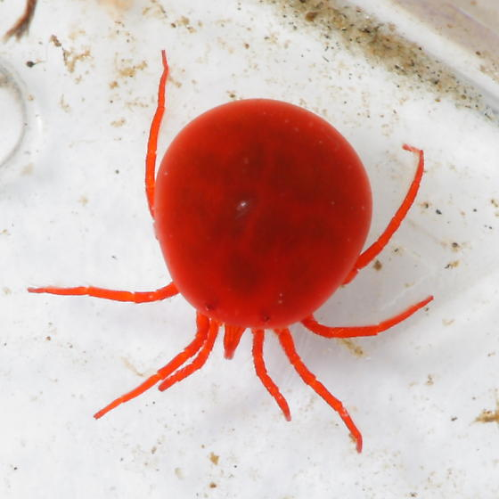
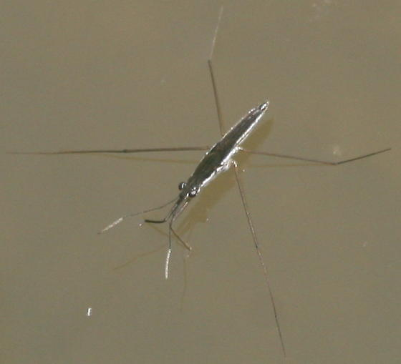
Sturgis McKeever, Georgia Southern University, Bugwood.org
DOCK FISHING SPIDER
Copyright © 2010 Stephen Luk
WATER MITE
Copyright © 2016 Tim Turner
WATER STRIDER
INVERTEBRATES

Slide 7
INVERTEBRATES
Dock Fishing Spider- These spiders are often found on the surface of the water, but can stay submerged for up to 30 minutes! They hunt for animals in and on the water, and only spin webs to protect their eggs.
Scientific/Latin: Dolomedes, sp., French-une araignée de pêche, Cree- apihkêsîs (spider), Michif- aen kaanookaat (spider)
Water Mite- These critters have 4 pairs of legs like a spider, but only one body section. Their larvae are parasitic and can be found feeding on other aquatic invertebrates.
Scientific/Latin: Order- Ancari (many species), French- un acarien
Water Strider- These insects look like spiders, but are not arachnids. They belong to the order “Hemiptera” which includes the true bugs (six legs, wings). Water striders use surface tension to stay atop the water, and find their prey by sensing ripples on the water’s surface.
Scientific/Latin: Family- Gerridae, French- un marcheur d'eau

Slide 8
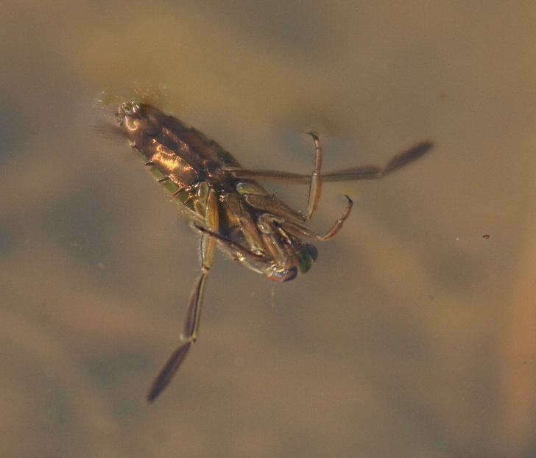
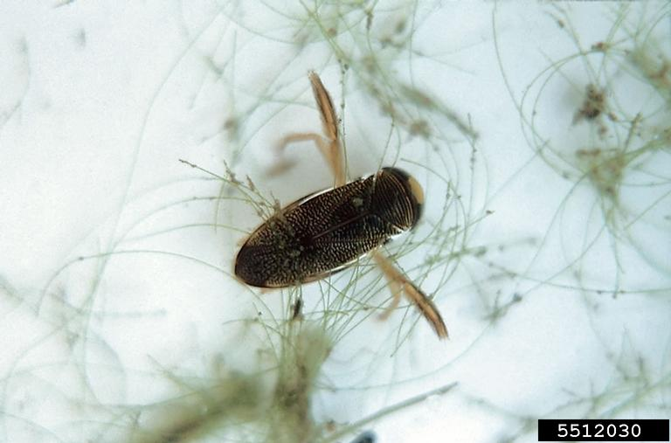
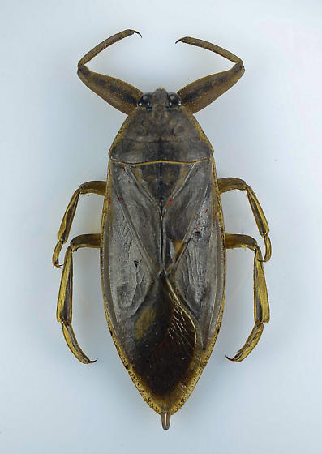
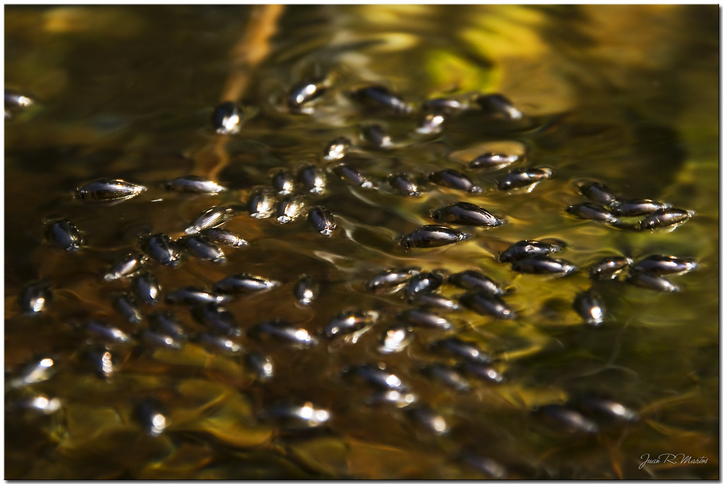
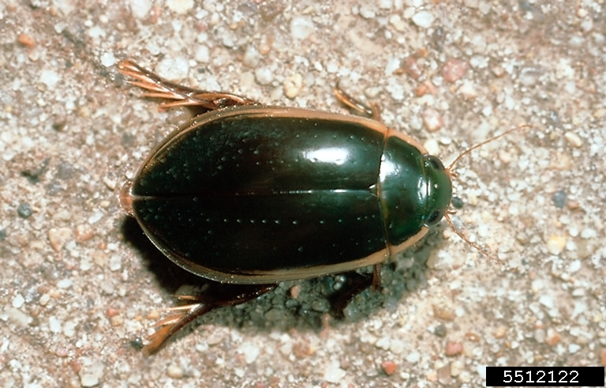
"Backswimmer" by Bushman.K is licensed under CC BY-NC 2.0
Kansas Department of Agriculture , Bugwood.org
BACKSWIMMER
BOATMAN
Copyright © 2015 Gary Griswold
"Escribano de agua / Water beetle" by Juan R. Martos is licensed under CC BY-NC-ND 2.0
Kansas Department of Agriculture , Bugwood.org
GIANT WATER BUG
WHIRLIGIG
PREDACIOUS DIVING BEETLE
BEETLES & BUGS

Slide 9
BEETLES & BUGS
MICHIF- Water bug/beetle- lii manichoosh di loo
Backswimmer- Are large (5-16mm) water bugs that swim on their backs. They orient themselves based on the light, so you can trick them into flipping over by shining a bright light below them. Scientific/Latin: Family- Notonectidae (many species), French- nageur arrière, Cree- manicôs (bug)
Waterboatman- Are excellent swimmers and fliers. These bugs breathe underwater by carrying a thin layer of air over their body and under their wings. They can easily escape your net by quickly flying away. Scientific/Latin: Family- Corixidae, French- un batelier de l’eau, Cree- manicôs (bug)
Giant Water Bug- Although this large bug is commonly called “toe biter”, giant water bugs prefer to hide or play dead when danger approaches. When they dive underwater, they carry air bubbles under their wings, and they also have a breathing tube to access air above the surface. Scientific/Latin: Lethocer us americanus, sp., French- une punaise d'eau géante, Cree- manicôs (bug)
Predacious Diving Beetle- Like their larvae, adult predaceous diving beetles are fierce predators that eat a variety of aquatic creatures. They can range from 5-40 mm in length and breathe by carrying an air bubble on the end of their abdomen. Scientific/Latin: Family- Dytiscidae, French- un coléoptère plongeur, Cree- amiskosîs,
Whirligig Beetles- Got their name from their habit of swimming in tight, fast circles on the surface of the water. They are smooth and round, and have flattened legs that act like oars when they swim. Scientific/Latin: Family- Gyrinidae (many species), French- un coléoptère tourbillonnant, Cree- amiskosîs

Slide 10
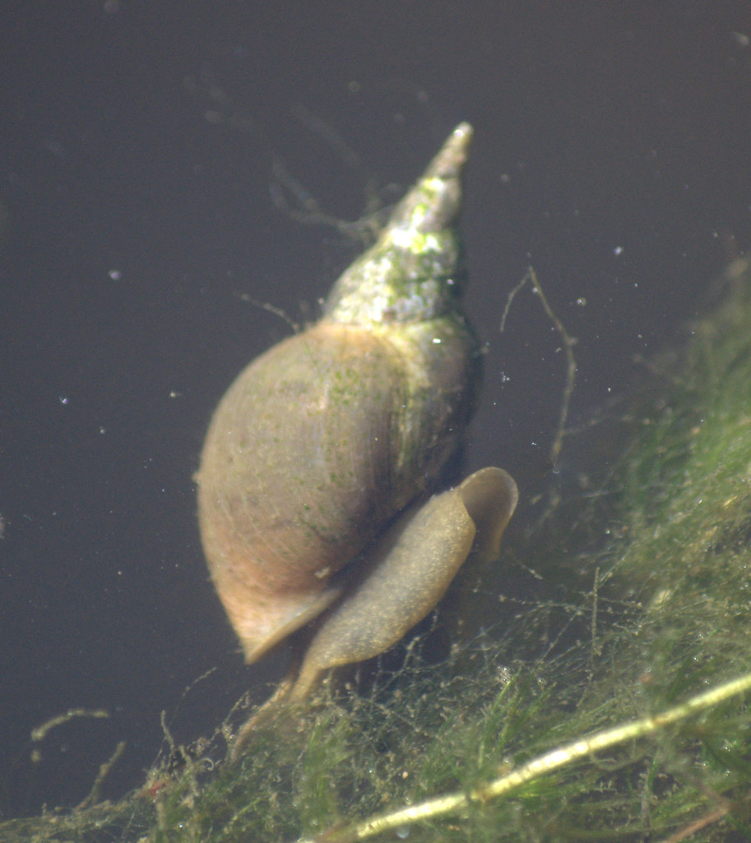
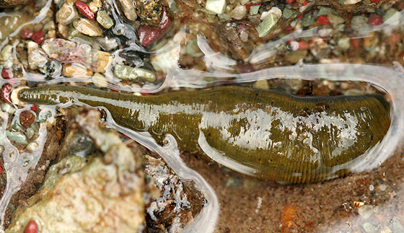
SNAIL & LEECH
"Great Pond Snail" by brianfuller6385 is licensed under CC BY-ND 2.0
Copyright © 2006 Lynette Elliott
POND SNAIL
LEECH

Slide 11
SNAIL & LEECH
Leech- There are 27 species of leeches found in Saskatchewan. They have the appearance of a flattened worm and can range from 10-100mm in length. While many people are afraid of leeches, only a few species feed on mammalian blood. One of our more common leeches eats snails.
Scientific/Latin: Class- Hirudinea, French- une sangsue, Cree- akahkway, Michif- aen akwamoot
·Pond Snail- these snails are very common, and can be identified by the right-hand opening to their shells. They are hermaphroditic (both male and female) and omnivorous, feeding on plant material, and dead animals. Scientific/Latin: Family- Lymnaeidae, French- un escargot d'étang, Cree- akahkway, Michif- snel

Slide 12
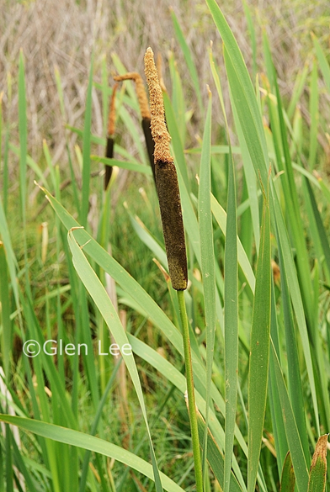
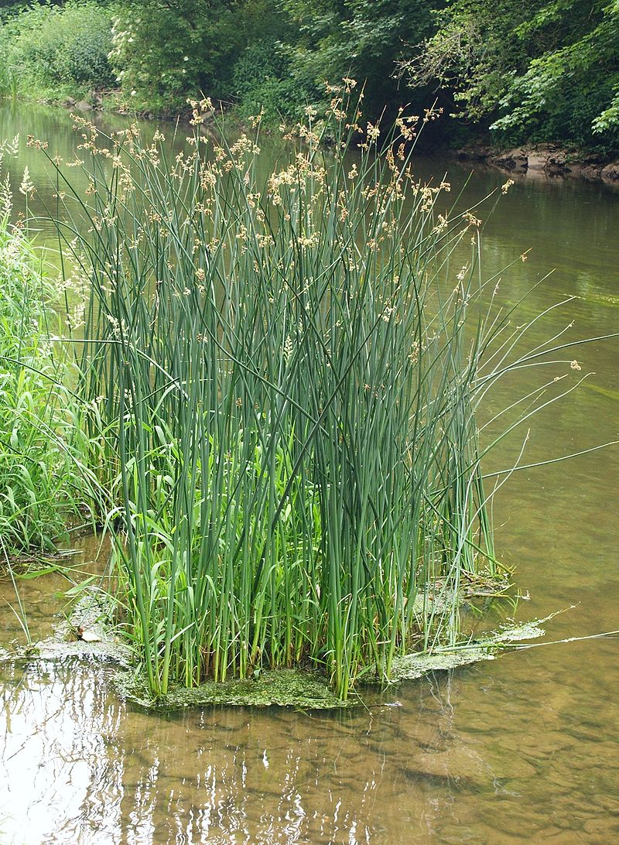
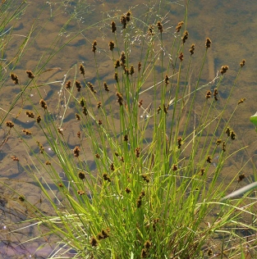
By Bernd Haynold - Own work, CC BY 2.5, https://commons.wikimedia.org/w/index.php?curid=548175
Edmonton Master Naturalists
CATTAIL
BULRUSH
SEDGE
POND PLANTS

Slide 13
POND PLANTS
Bulrush- Bulrush is a common name for a group of monocots that have a 3-sided stem, and small inflorescence at the top, or mid-way up the stem. Bulrushes grow densely along the shoreline of aquatic habitats, and have succulent rhizomes that are a favorite snack for bears. Scientific/Latin: Scirpus, sp., French- jonc, Cree- pasihkân
Sedges- Sedges are a group of monocots that are distinguished by their triangular stems (sedges have edges). Sedges found in aquatic environments will generally grow in “tufts” along the shore, and have small, spiky flower clusters at the top of their stems. Scientific/Latin: Family- Cyperaceae (many species), French- le carex
Cattail- Cattails are one of the most abundant and easily recognizable wetland plants. Humorously referred to as “wild corndogs”, the flowering head is easily seen at a distance. The roots of the cattail form a network of habitat and food for birds, muskrats, invertebrates, and more. It is truly the backbone of a wetland ecosystem. Scientific/Latin: Typha latifolia, French- la quenouille, Cree- pasân

Slide 14
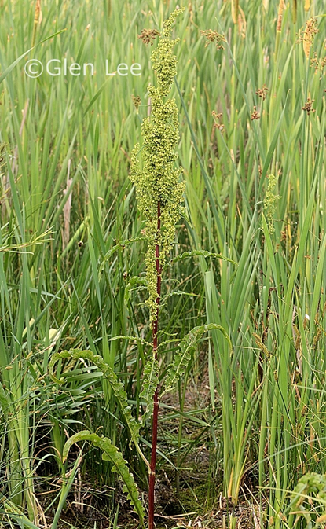
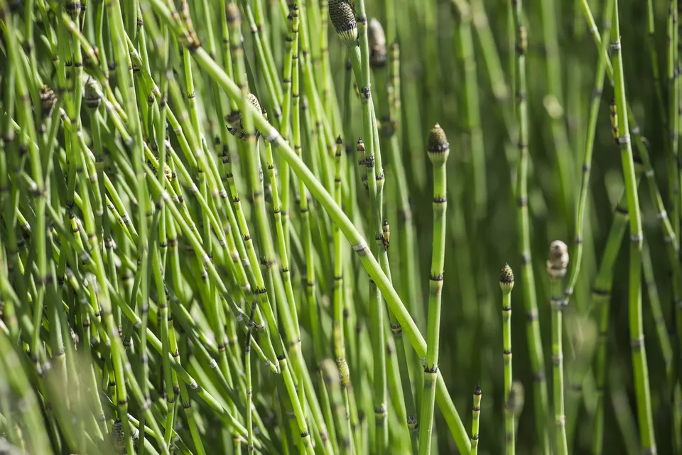
Frederic Cirou/Getty Images
HORSETAIL
WESTERN DOCK
POND PLANTS

Slide 15
POND PLANTS
Western Dock- There are several varieties of dock found in Saskatchewan. It is found in wetlands, ditches, and wet meadows. In spring, the fluorescence is green, but becomes reddish brown in late summer, making it easy to identify. Scientific/Latin: Rumex occidentalis
Horsetail- Also called “puzzle grass” or “common scouring rush”, horsetails are one of the oldest living ancestors of modern plants. They pre-date seeds, and reproduce using spores found on a spore cluster at the top of the stalk. The stems contain abrasive silica which makes them unpalatable to grazing animals, but excellent for filing your nails! Scientific/Latin: Equisetum hyemale, French- la prêle, Cree- miscanikwacâsôsôsa

Slide 16
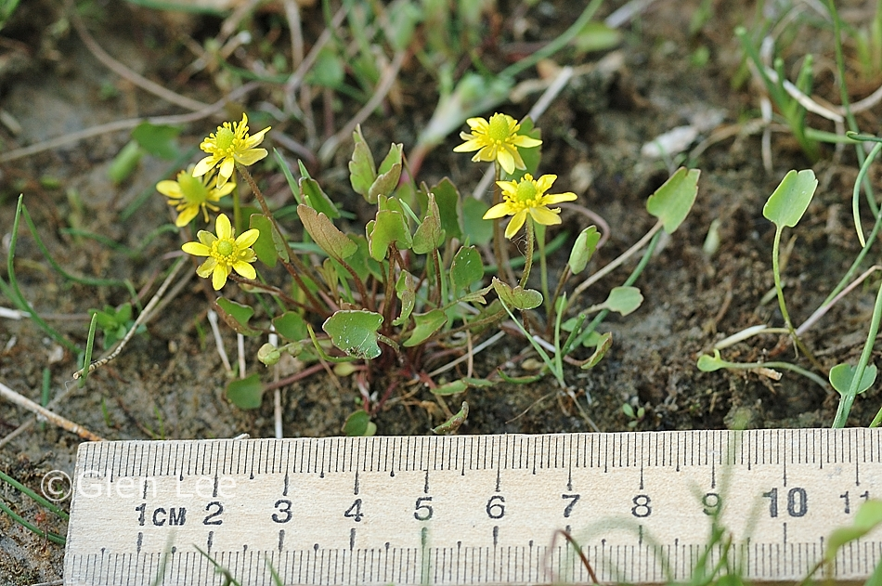
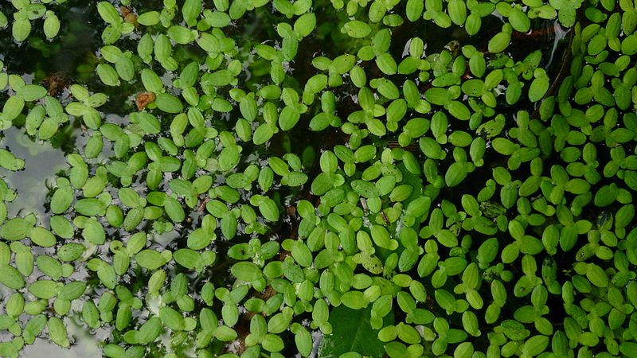
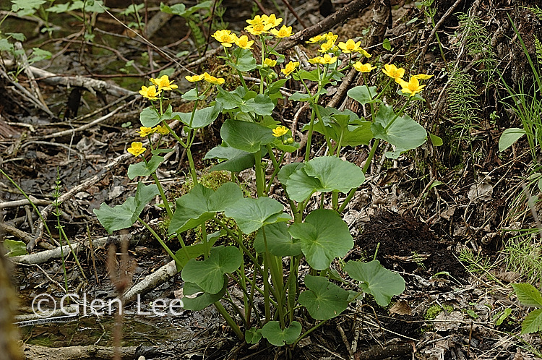
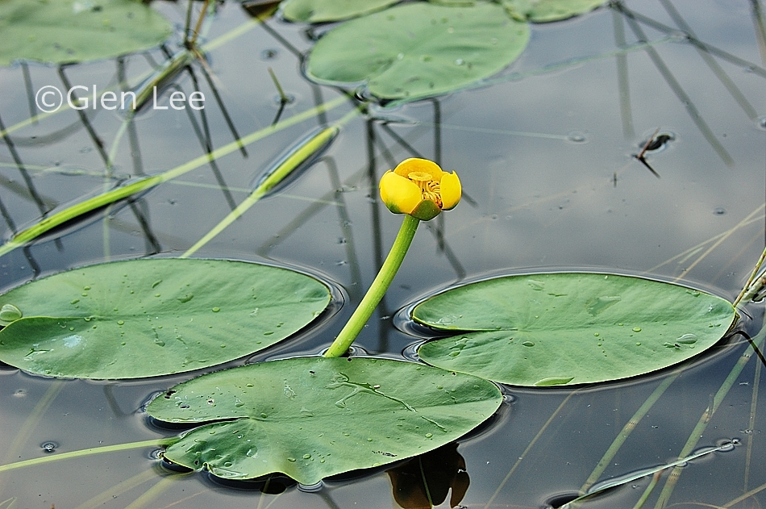
SEASIDE BUTTERCUP
COMMON DUCKWEED
MARSH MARIGOLD
YELLOW POND LILY
POND PLANTS

Slide 17
POND PLANTS
Seaside Buttercup- There are many species of buttercup found in Saskatchewan, but this is the one you are most likely to find near a wetland. The flower has five yellow petals, interspersed with five green sepals. If you pick a buttercup, you will find that the sap irritates your skin, so its best to leave them in their place! Scientific/Latin: Ranunculus cymbalaria, French- une renoncule en bord de mer
Common Duckweed- Common duckweed is a free-floating aquatic plant that forms mats on the surface of the water. It is so successful at reproducing that it is considered invasive in some parts of the world. It’s primary method of reproduction is asexual budding, but it does have tiny flowers for sexual reproduction. Scientific/Latin: Lemna turionifera, French- la lentille d’eau
Yellow pond lily- The yellow pond lily is one of the plants that produces leaves that most people recognize as “lily-pads”. The leaves, seeds, and rhizomes can be prepared as food, and are commonly eaten by moose, beaver, muskrat, fish, birds, and invertebrates. Scientific/Latin: Nuphar variegata, French- un nénuphar jaune
Marsh Marigold- These bright, yellow flowers grow in bunches on the margins of aquatic environments. Although some people consider this an edible plant, it is poisonous to humans unless prepared correctly. Scientific/Latin: Caltha palustris

Slide 18
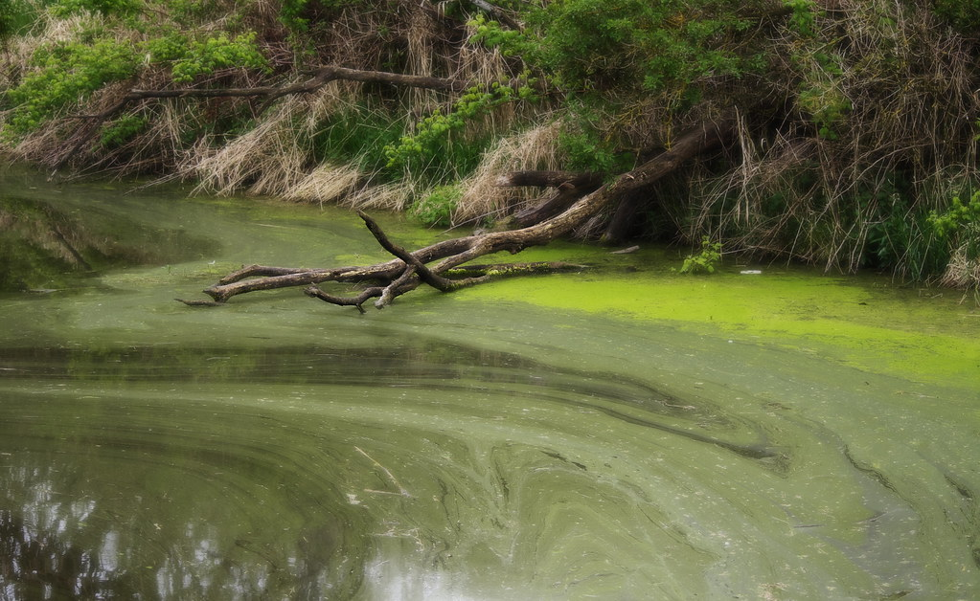
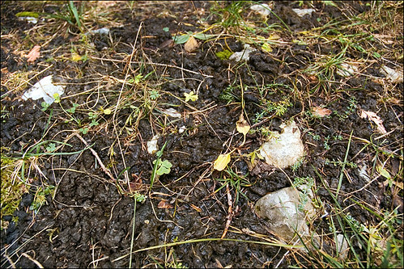
ALGAE
"The alien pond" by Neillwphoto is licensed under CC BY-SA 2.0
ALGAL BLOOM
"Nostoc commune_2" by amadej2008 is licensed under CC BY-NC-SA 2.0
NOSTOC

Slide 19
ALGAE
There are many types of algae ranging from single-celled cyanobacteria, to multicellular “sea weeds”. Their common features are that they have no true roots, stems, or leaves, and no vascular tissue to transport water and nutrients.
Algae can be found in the most temporary wetlands. Even in small depressions in the arid grasslands where water gathers, Nostoc (a form of algae) will gather and reproduce when water is present, then dehydrate completely when the puddle dries up!
Algal blooms can become a problem when aquatic environments become concentrated with nutrients, usually from fertilizer runoff or human/animal waste. These excessive nutrients cause algae to grow, and begin decomposing in large mats. This decomposition consumes the oxygen in the aquatic environment, and suffocates the other organisms living there.

Slide 20
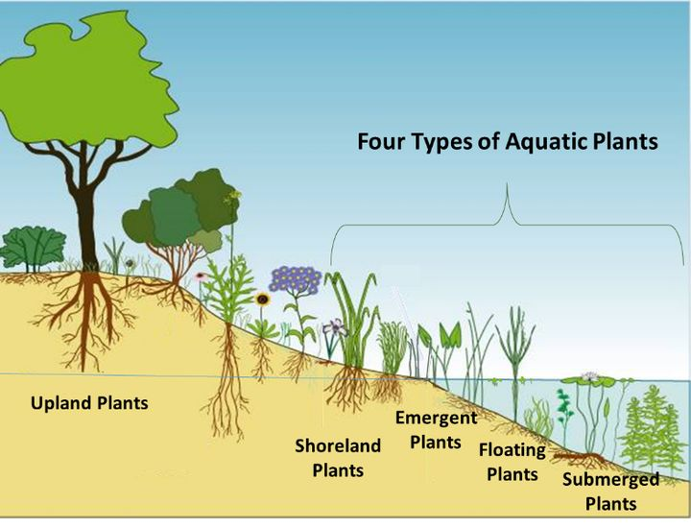
POND PLANTS
Beth Clawson, Michigan State University Extension - April 2, 2018

Slide 21
POND PLANTS
The four categories of aquatic plants are:
Submerged: Plants that thrive under water that have roots in the soil at the bottom (pond weed and bladderwort)
Floating: Plants that float at or near the water surface and have either floating roots or roots in the soil at the bottom (duckweed and lily pads)
Emergent: Plants that are rooted in the soil under water, but the larger part of the plant is above water (arrowhead, rushes and cattails)
Shoreline: plants that prefer the shore, but can take being moist and flooded seasonally (blue flag iris, some shrubs and trees).
Aquatic plants benefits include:
Algae control. Plants absorb nutrients in the water from fish waste and reduces nutrient availability slowing algae blooms.
Shade and protection. Plants can provide a hiding place for critters from predators both above and below the water. Additionally, plants shade the water reducing the amount of sunlight entering the water helping to slow algae blooms.
Food for fish and other wildlife. Fish, turtles, insects, ducks and geese and some mammals feed on aquatic plants.
Improved water quality. Many water plants not only absorb nutrients from the water, they also absorb pollutants and heavy metals too.
Erosion control. Emergent and shoreline plants often have very large root structures. This enables them to reduce wave action and stabilize the shore creating the most effective erosion control you can get in a pond.

Slide 22
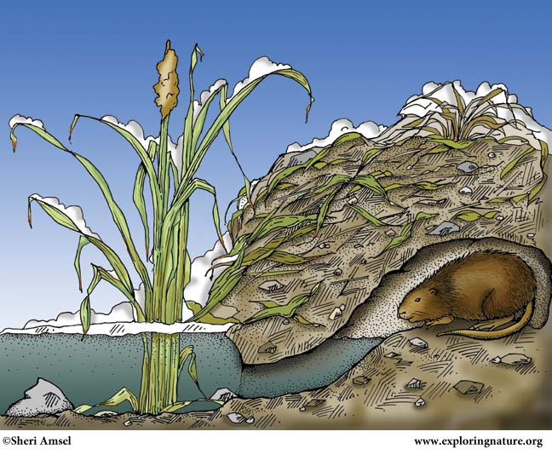
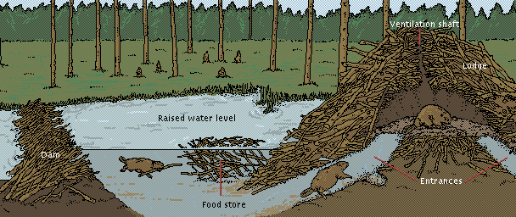
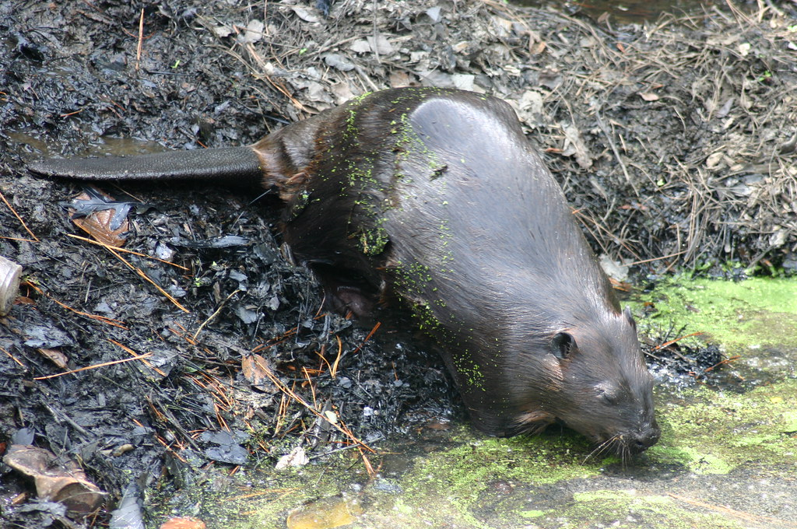
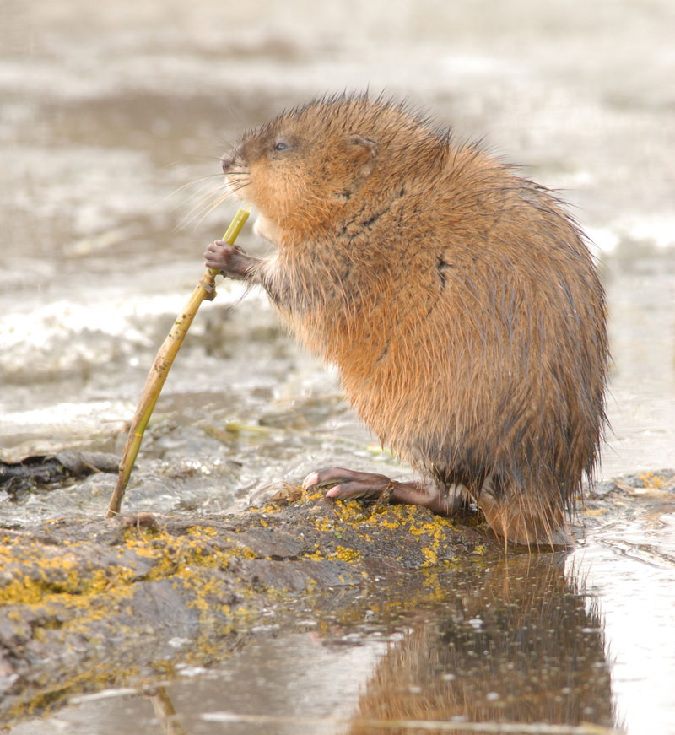
BEAVERS & MUSKRATS
Photo: Derald Lobay
"Beaver" by Ryan Somma is licensed under CC BY-SA 2.0
BEAVER
MUSKRAT

Slide 23
BEAVERS & MUSKRATS
Beaver- Beavers are famously busy, and are second only to humans in their ability to manipulate and change their environment. When sites are available, beavers burrow in the banks of rivers and lakes but when they are not, they make their own ponds by building a dam. They have super strong front teeth and powerful jaws to bring down trees to build their structures. Their lodges are dome shaped and are built of mud and branches, in the middle of ponds. They have secret underwater entrances. Beavers are among the largest rodents and are herbivores, feeding on leaves, twigs, roots and aquatic plants. They are awkward on land but graceful in the water. They are well suited to life in water with webbed feet, paddle-shaped tails that act as rudders, transparent eyelids, that act like goggles, and their fur is waterproof. Scientific/Latin- Castor canadensis, French- un castor, Cree- amisk, Michif- aen kaastor
Muskrat- Are excellent swimmers, moving as fast as 3 miles per hour. They can even swim backwards and can stay underwater for up to 20 minutes. They can find food during the winter under a metre of ice and snow, in freezing cold water and almost total darkness. Muskrats have specially evolved teeth that protrude beyond its cheeks and lips, that can close behind them, allowing them to chew on plants under water ‘with its mouth closed’. The Muskrat’s name is derived by its special musk glands, near its anus. The glands enlarge during the breeding season and produce a yellowish, musk substance that it uses to mark different points of interest. Muskrats make burrows in banks or lodges under dead-looking heaps of plant material. Scientific/Latin- Ondatra zibethicus, French- un rat musqué, Cree- wacask, Michif- aen raa doo

Slide 24
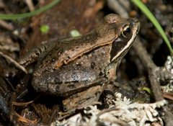
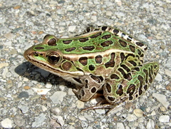
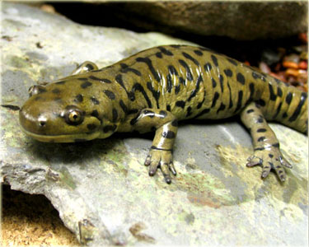
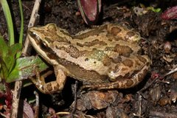
WOOD FROG
NORTHERN LEOPARD FROG
Amphibian Growth Project, 2012.
WESTERN TIGER SALAMANDER
BOREAL CHORUS FROG
AMPHIBIANS

Slide 25
AMPHIBIANS
Western Tiger Salamander- They prefer open landscapes and can be found far from water. They don’t need to drink water, they get hydrated by sitting in puddles. Salamanders need fishless ponds to lay their eggs, otherwise fish gobble them up. Scientific/Latin: Ambystoma mavortium, French- une salamandre, Michif- aen lizaar
Northern Leopard Frog- Tadpoles are herbivores, and adults are carnivores which reduces competition between generations. They get their name from the spots on their back. Scientific/Latin: Lithobates pipiens, French- une grenouille, Cree- aýîk, Michif- en goornouy
Boreal Chorus Frog- Boreal Chorus Frog are hard to see but easy to hear. The chorus of high-pitched trills has been compared to a fingernail running along the edge of a plastic comb. Scientific/Latin: Pseudacris maculata, French- une grenouille, Cree- aýîk, Michif- en goornouy
Wood Frog- Has a rapid, low vocalization that is often mistaken for a duck quack. Wood frogs hibernate in the winter, and have a special glucose that acts as an anti-freeze so that they can survive almost being frozen solid! Scientific/Latin: Lithobates sylvaticus, French- une grenouille, Cree- aýîk, Michif- en goornouy

Slide 26
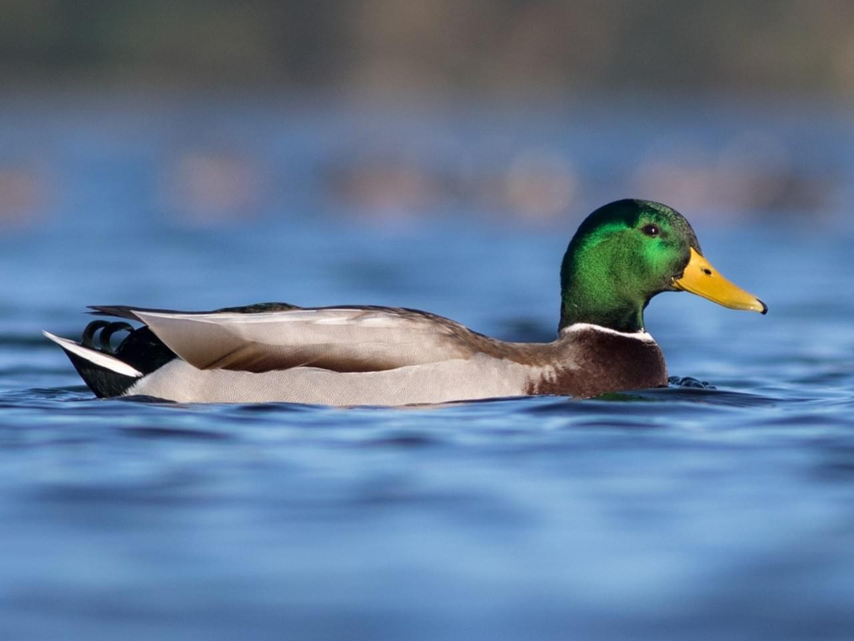
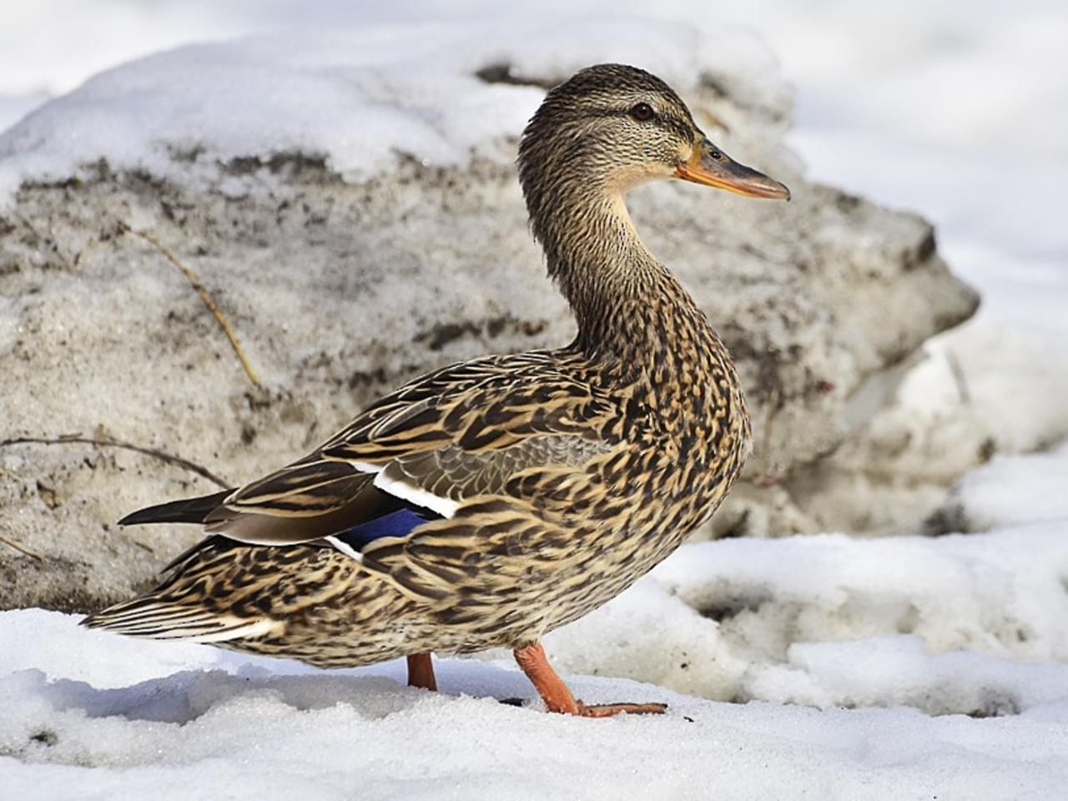
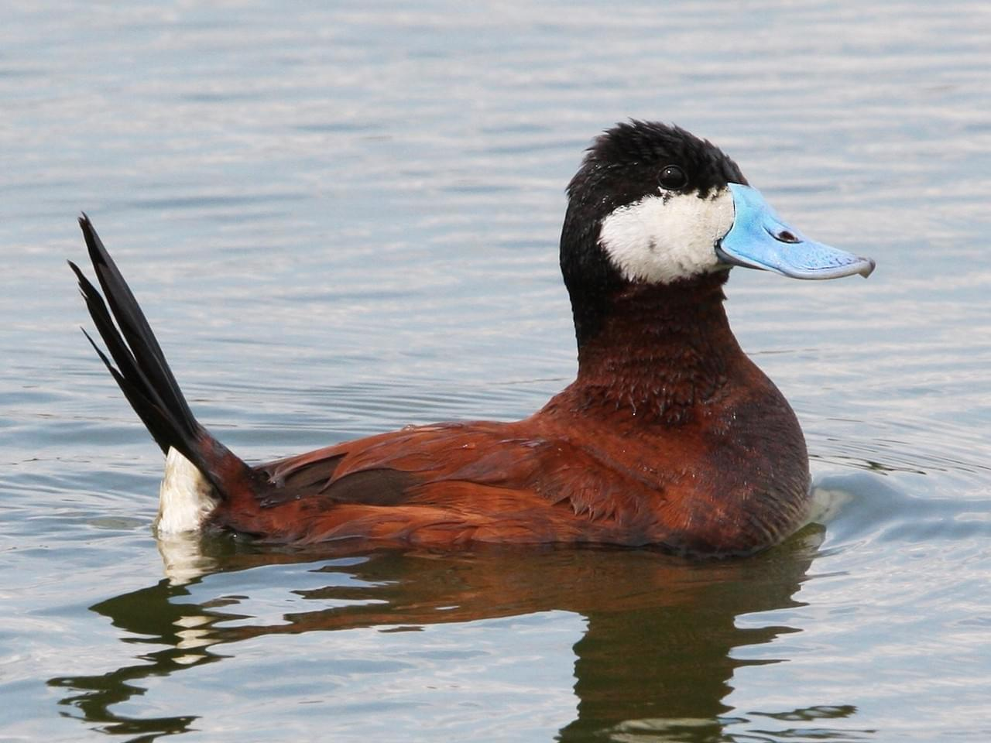
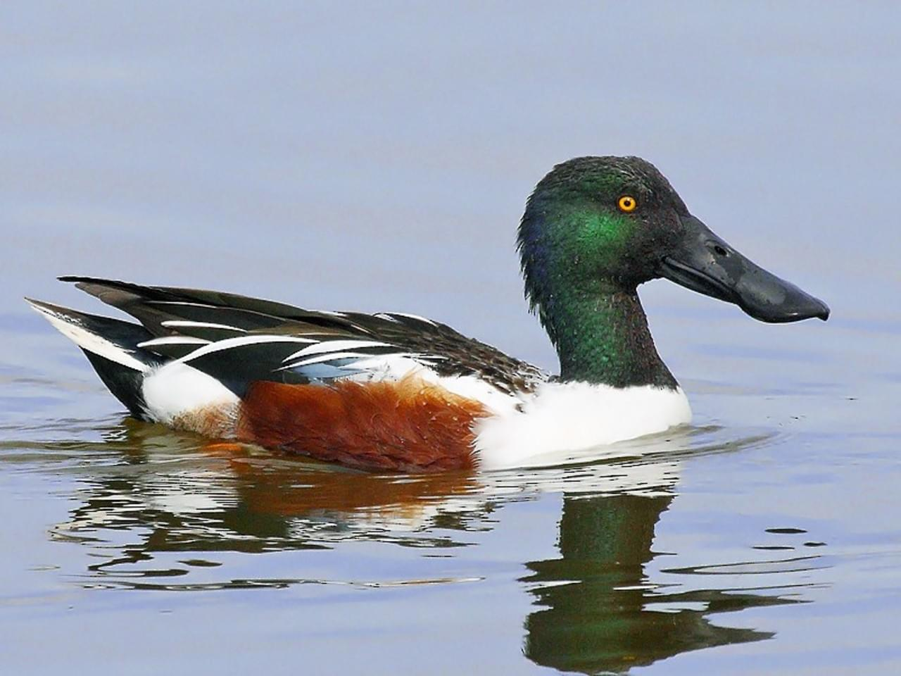
DUCKS
© Liron Gertsman
© Steeve R. Baker
MALLARD
FEMALE MALLARD
© Christoph Moning
© Paul Hueber
RUDDY DUCK
NORTHERN SHOVELLER

Slide 27
DUCKS
Mallard Duck (Male/Female)- The Mallard Duck is thought to be the most abundant and wide-spread duck in the world! The male is called a drake and has a distinctively coloured iridescent green head. The mallard duck’s outer feathers are waterproof, thanks to oil that’s secreted from a gland near the tail. Did you know that if a predator is nearby, a mother mallard will pretend to be injured to distract if from her brood?
Scientific/Latin- Anas platyrhynchos, French- un canard colvert, Cree- iyinisip, Michif- li kanaar (duck)
Ruddy Duck- Ruddy Ducks are small with a scoop-shaped bill and a long stiff tail that is often held up. Breeding males have a blue bill and chestnut bodies. They spend the vast majority of their time in the water and tend to swim and dive rather than fly to escape predators.
Scientific/Latin- Oxyura jamaicensis, French- un canard roux, Cree- sîsîp (duck), Michif- li kanaar (duck)
Northern Shoveller- These ducks are often called “spoonbills” because of their unique spatula-shaped bills. Its uniquely shaped bill has comblike projections along its edges, which filter out tiny crustaceans and seeds from the water. The breeding male has a green head, white body, reddish brown flanks and a black bill.
Scientific/Latin- Spatula clypeata, French- un pelleteur du Nord, Cree- sîsîp (duck), Michif- li kanaar (duck)

Slide 28
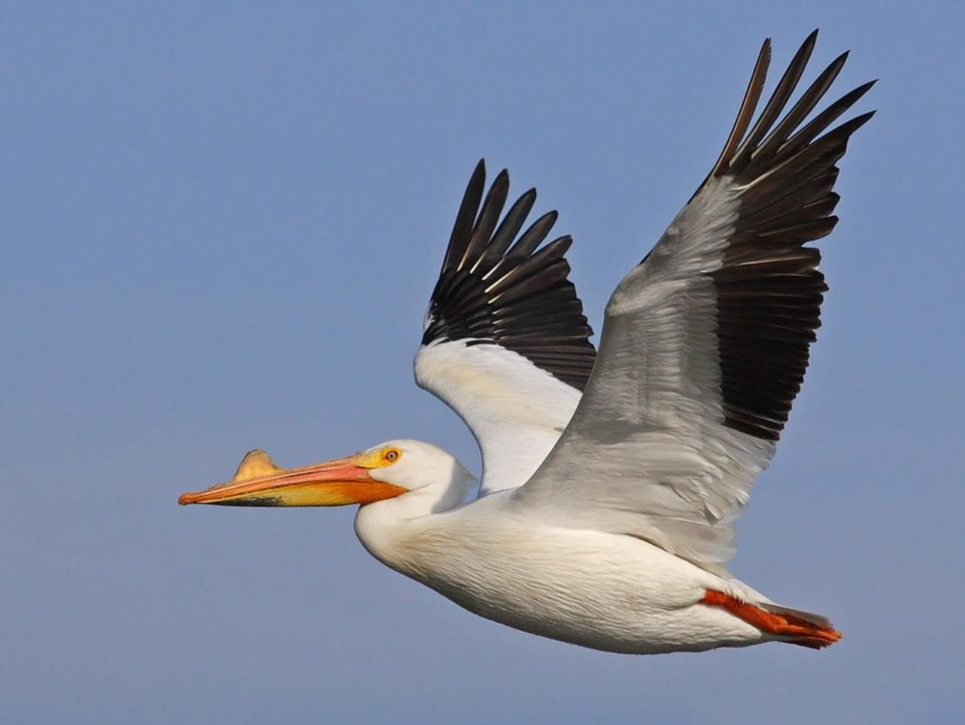
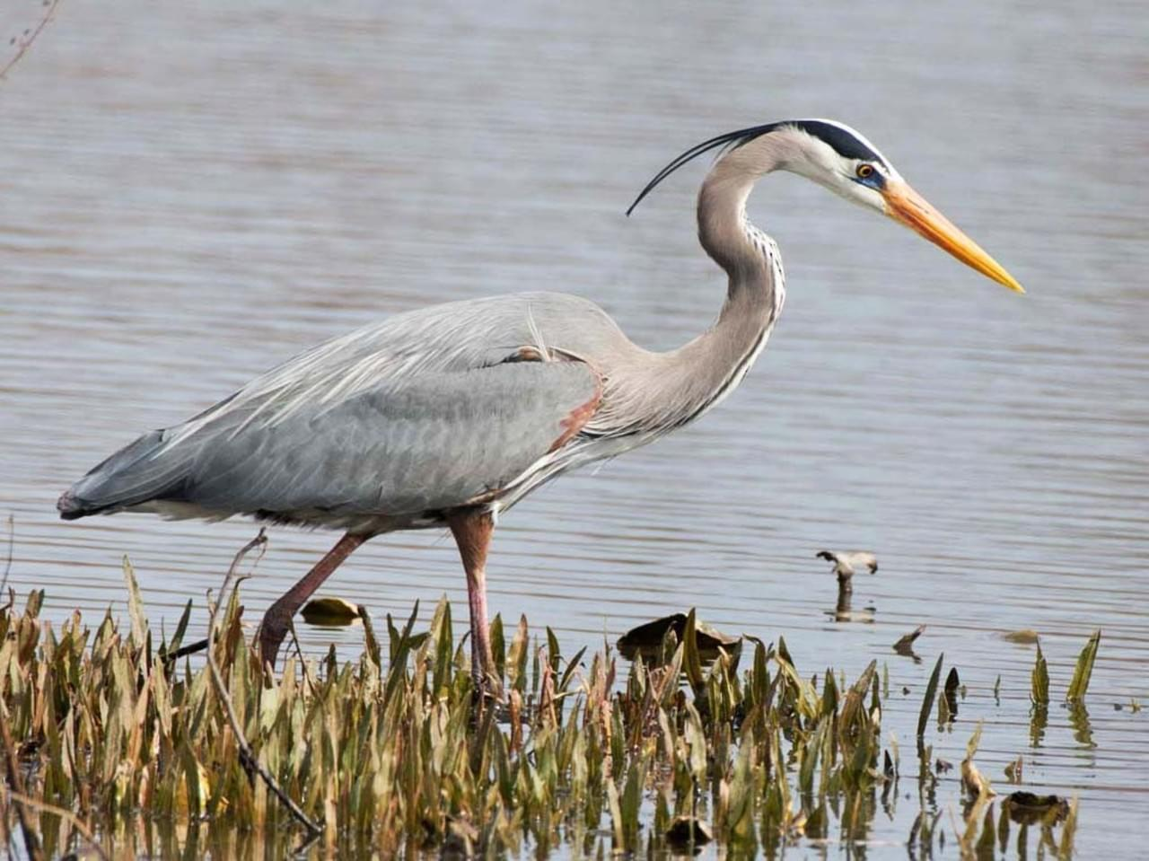
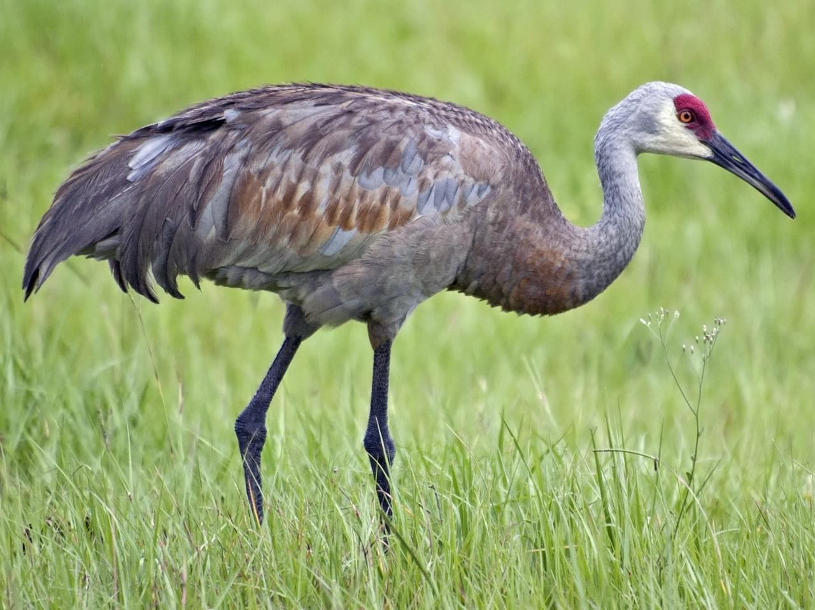
© Paul Hueber
AMERICAN WHITE PELICAN
© Janis Stone
© Liam Wolff
GREAT BLUE HERON
SANDHILL CRANE

Slide 29
BIRDS
American White Pelican- One of the largest birds in North America, with a nine-foot wingspan! They have a very long, orange bill and forage by swimming on the surface, dipping their bills to scoop up fish, then raising their bills to drain water and swallow their prey. Though females lay two eggs, only one chick typically survives.
Scientific/Latin- Pelecanus erythrorhynchos, French- un pélican blanc, Cree- cahcahkiw, Michif- aen nwayzoo avik enn graan boosh
Sandhill Crane- Sandhill cranes are very large, tall birds with a long neck, long legs and broad wings. They are known for their dancing skills and when courting they stretch their wings, pump their heads, bow and leap in to the air in a graceful and energetic dance. Most cranes lay just two eggs and usually only one survives.
Scientific/Latin- Grus canadensis, French- une grue du Canada, Cree- ocicâhk, Michif- lii greu
Great Blue Heron- Great Blue Herons are very tall and stand 3 to 4.5 feet tall. In flight, they look huge, with a 6 foot wingspan. Thanks to specially shaped neck vertebrae, Great Blue Herons can quickly strike prey at a distance, feeding on fish, amphibians, reptiles, small mammals and even other birds.
Scientific/Latin- Ardea herodias, French- un grand héron bleu, Cree- mohkahasiw, Michif- aen bitorr

Slide 30
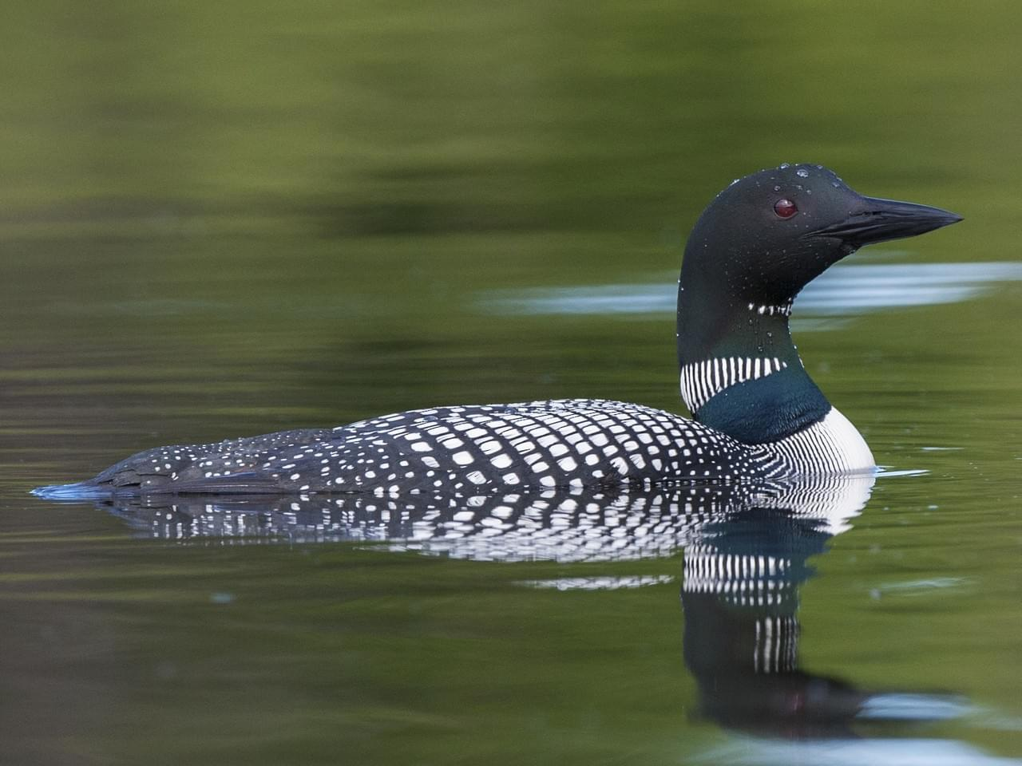
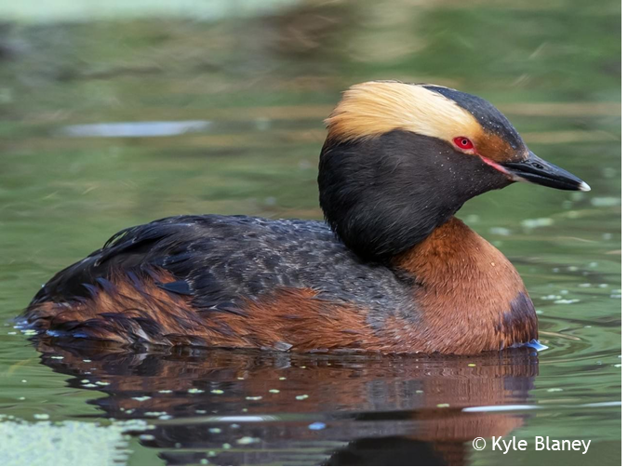
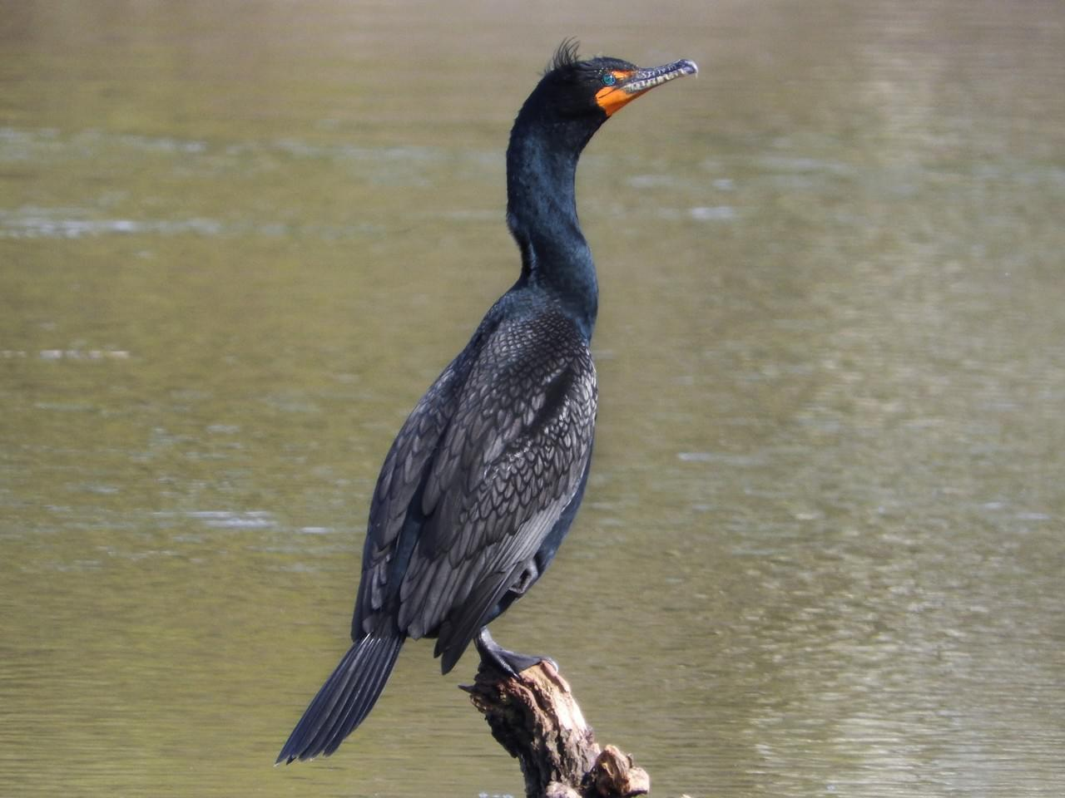
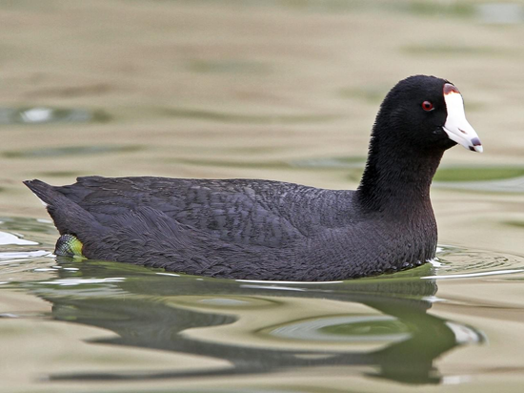
© Cliff Peterson
© Davey Walters
LOON
HORNED GREBE
© Anonymous eBirder
DOUBLE-CRESTED CORMORANT
© Christoph Moning
COOT

Slide 31
BIRDS
American Coot- American Coots are noisy, gregarious members of the rail family. The coot has large feet with lobed toes. They build floating platforms made of stems of marsh plants for a nest. Scientific/Latin- Fulica americana, French- une foulque américaine, Cree- sihkihp
Common Loon- Loons are designed for water and in fact, only go to shore to mate and incubate eggs. Loons can dive more than 200 feet underwater in search of food! It has sharp projections on the roof of its mouth and tongue that help it hold on to slippery fish and other prey. Scientific/Latin- Gavia immer, French- un plongeon huard, Cree- mâkwa, Michif- aen looyaar
Horned Grebe- A small waterbird that dives underwater for food and picks insects off the water surface. It’s “horns” are yellowish patches of feathers behind its eyes that it can raise and lower at will. Scientific/Latin- Podiceps auritus, French- un grèbe cornu, Cree- sihkihp, Michif- aen nwayzoo ka kookiit
Double-Crested Cormorant- These birds are skilled in diving for small fish. In the breeding season, a Double-crested Cormorant’s throat turns bright orange. To incubate their eggs, adults hold them on their feet. Cormorants often stand in the sun with their wings spread to dry out as they have less oil than other birds, so their feathers can get soaked. Scientific/Latin- Phalacrocorax auritus, French- un cormoran, Cree- kâhkâkîsip, Michif- aen kanaar nwaenr

Slide 32
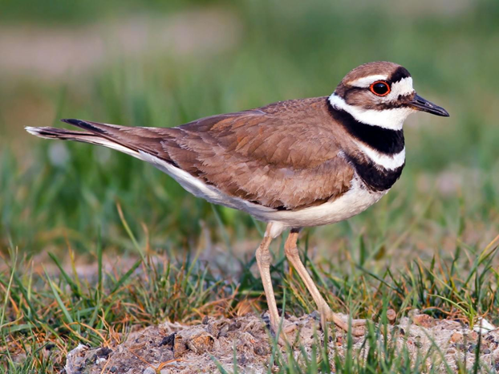
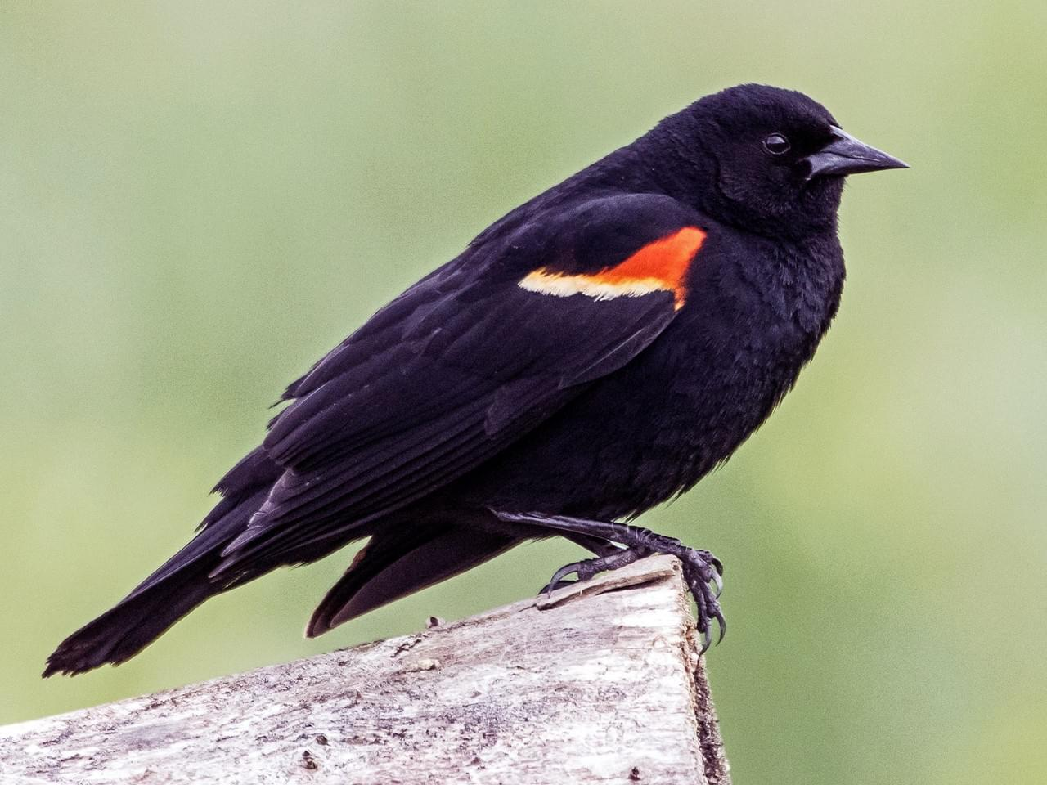

WATER FOWL
© Phil Kahler
KILLDEER
RED WINGED BLACKBIRD
© Joe Bailey
FRANKLIN’S GULL

Slide 33
BIRDS
Red-winged Blackbird- Red-winged Blackbirds are common in cattail marshes and other wetlands. Listen for the male’s “conk-la-ree” song. During the breeding season, male red-winged blackbirds fiercely defend their territories. They chase other males away and attack nest predators.
Scientific/Latin- Agelaius phoeniceus, French- un merle à ailes rouges, Cree-cahcahkâýôsis, Michif- aen nwayzoo nwaenr
Franklin’s Gull- A small gull with a black head, a red bill and white eye crescents. They nest in freshwater marshes with lots of vegetation and patches of open water. They form large colonies of hundreds or thousands of birds, often nesting less than two feet from each other.
Scientific/Latin- Leucophaeus pipixcan, French- une mouette de Franklin, Cree- kîyâsk, Michif- aen moov
Kill Deer- Killdeer get their name from the shrill “kill-deer” call they often give. These birds are known for their “broken-wing act” display in attempt to lure predators away from their nest. Killdeer nests are simple depression on open ground in areas with sparse vegetation. Their eggs are spotted and speckled so are nicely camouflaged.
Scientific/Latin- Charadrius vociferus, Cree- otâpiskâkanêsîs, Michif- aen bekas

